Slide 1

Baskerville Portal
EPSRC Tier 2 HPC System
University of Birmingham

Slide 2
Overview
What is Baskerville Portal?
Connect and Configure Baskerville Portal
JupyterLab
Module Loading
Conda Environments
Final Task: Build PyTorch in a Conda Environment

Slide 3
1. What is Baskerville Portal?

Slide 4
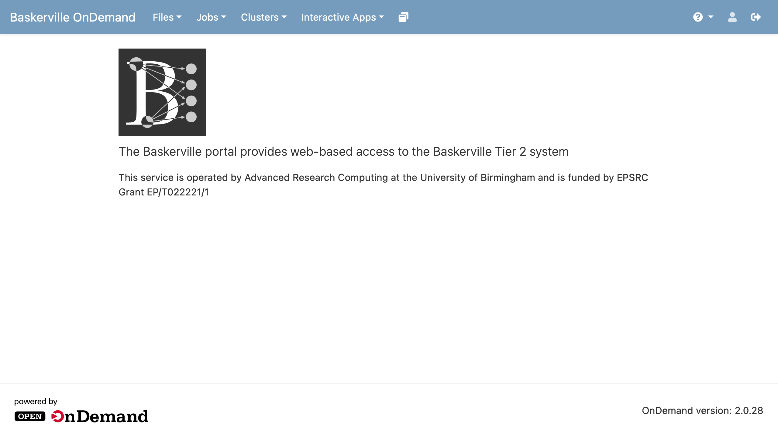
portal.baskerville.ac.uk/
Notes:
All you need is a web browser – no need for SSH clients
Access to Terminal, run jobs, view files, and use GUI applications such as JupyterLab

Slide 5
2. Connect and Configure Baskerville Portal

Slide 6
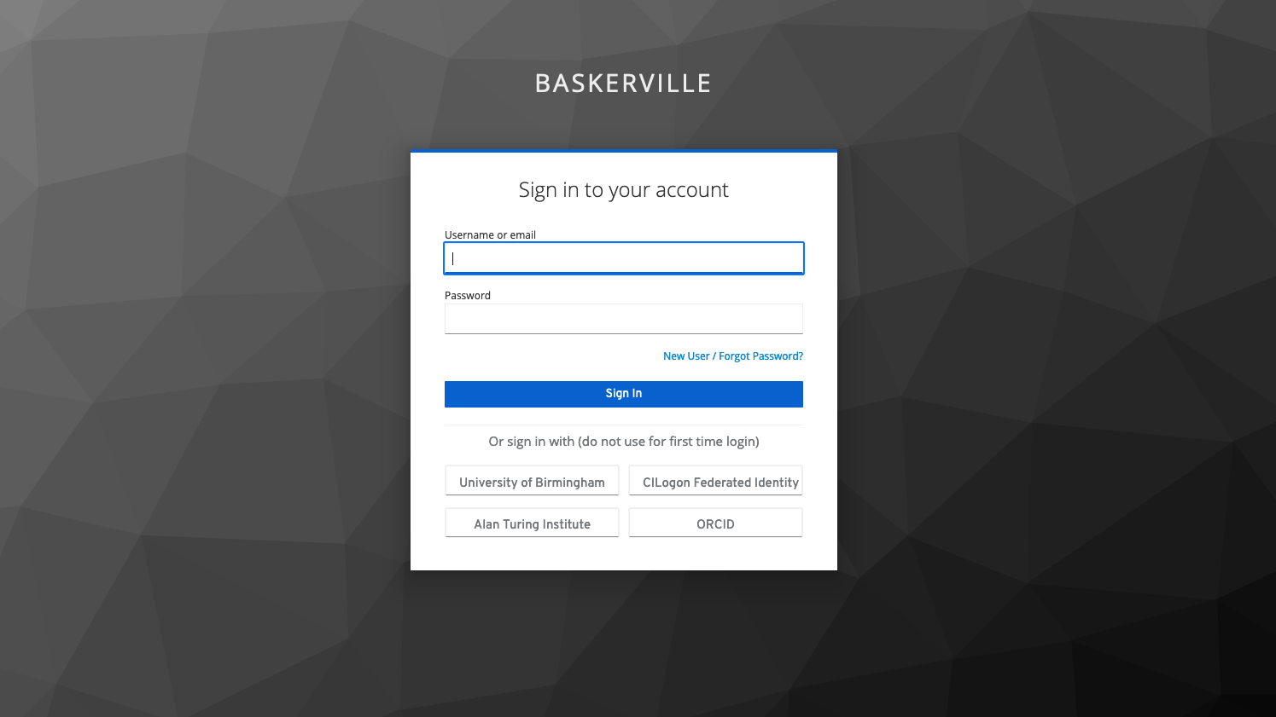
Notes:
learners should have a Baskerville account already registered
2 ways to log in:
Username/email and Password, followed by an OTP
Single Sign On, e.g. University of Birmingham, Alan Turing Institute, CILogon Federated Identity, ORCID

Slide 7

Open a Terminal
Click Clusters > Baskerville Tier 2 HPC Shell Access, enter your Password and OTP to access a Terminal.
to see information about your Baskerville projects and available QoS.
This information is also available at admin.baskerville.ac.uk/.
Note: OTP – One Time Passcode, QoS – Quality of Service/Queue
Notes:
Projects are created by the PI. Used to account for time used on the cluster.
Notice that once you are connected, the command line prompt has changed to show your username, hostname, and current working directory

Slide 8
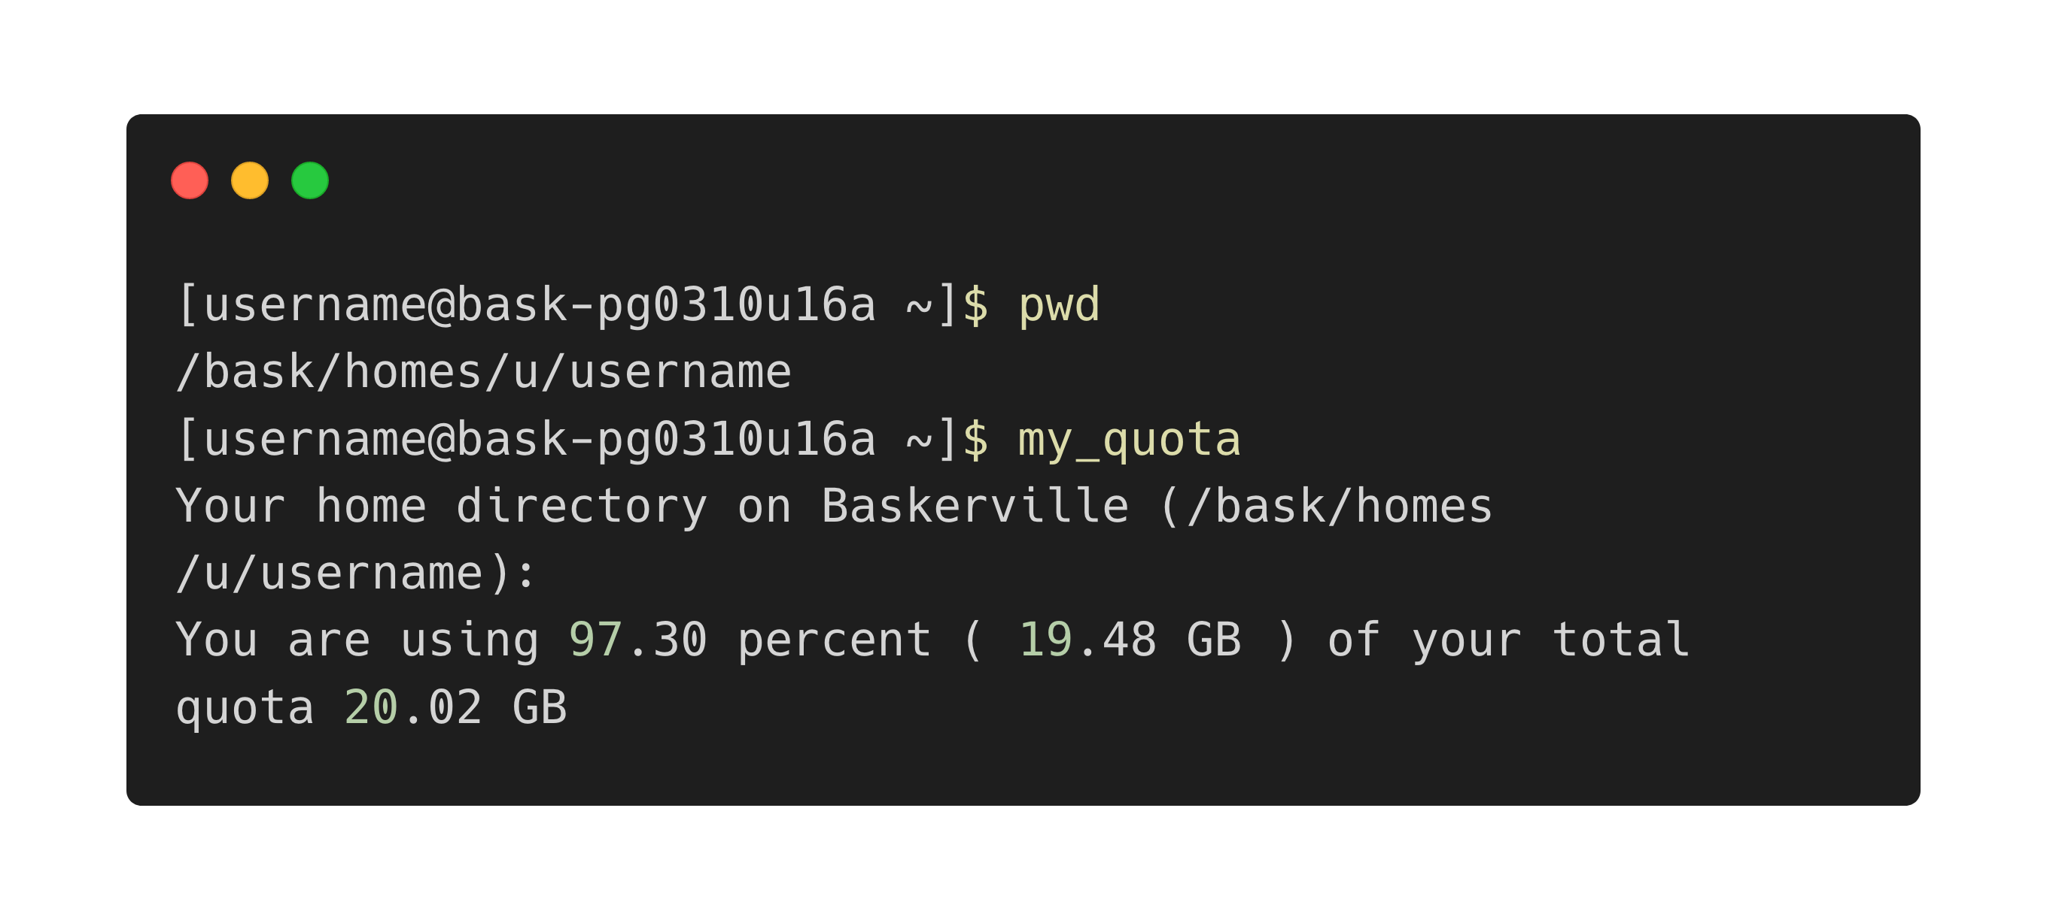
Your home folder | 20GB

Slide 9
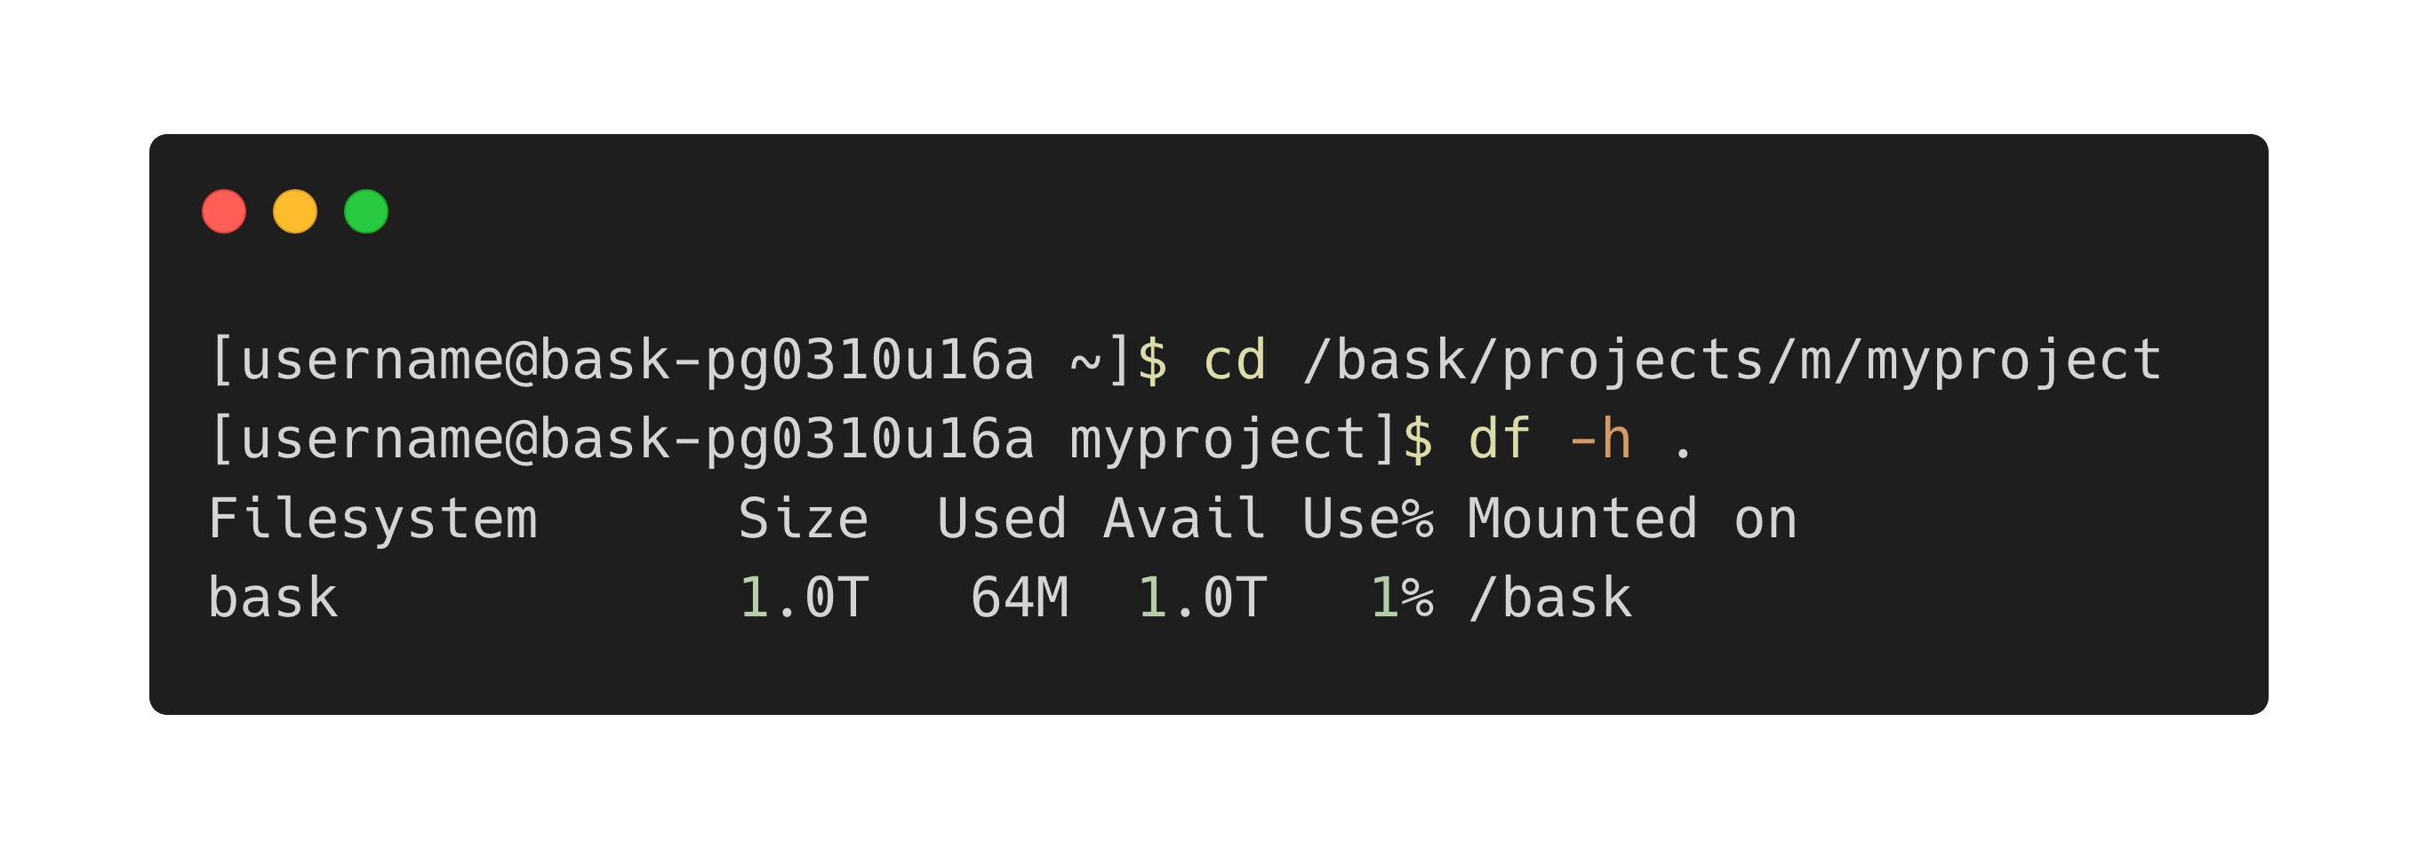
Your project folder | 1TB
Notes:
Path to project folder can be found in my_baskerville or Baskerville Admin (see 2 slides prior)

Slide 10
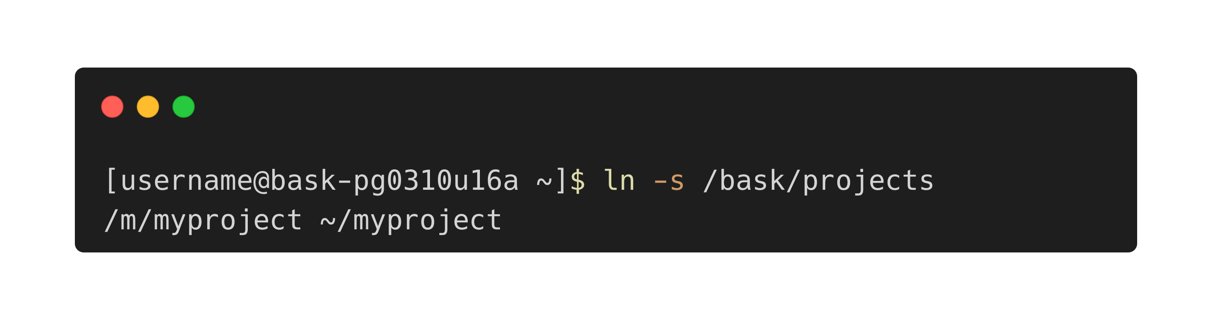
Symlink your home and project folder
For JupyterLab, only the home folder is accessible from the GUI
Solution - Access data in your project folder from your home folder via a symbolic link. Configure this with:
Notes:
Soft links can be used for linking directories whereas hard links cannot

Slide 11
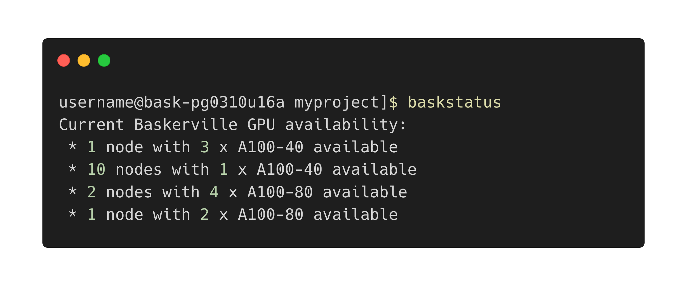
baskstatus - Query Available GPUs

Slide 12
3. JupyterLab

Slide 13
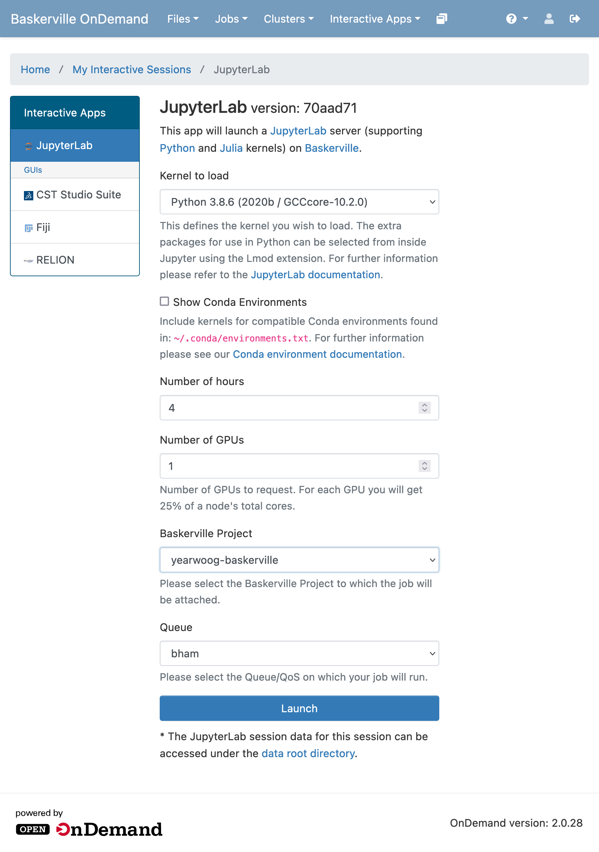
Launch a JupyterLab server
Click Interactive Apps > JupyterLab
Load Python kernel
Request Resources - number of hours and number of GPUs
Select Project and Queue
Click Launch to launch JupyterLab server
myproject
myqueue
Notes:
Select Project and Queue from a dropdown list of available options

Slide 14
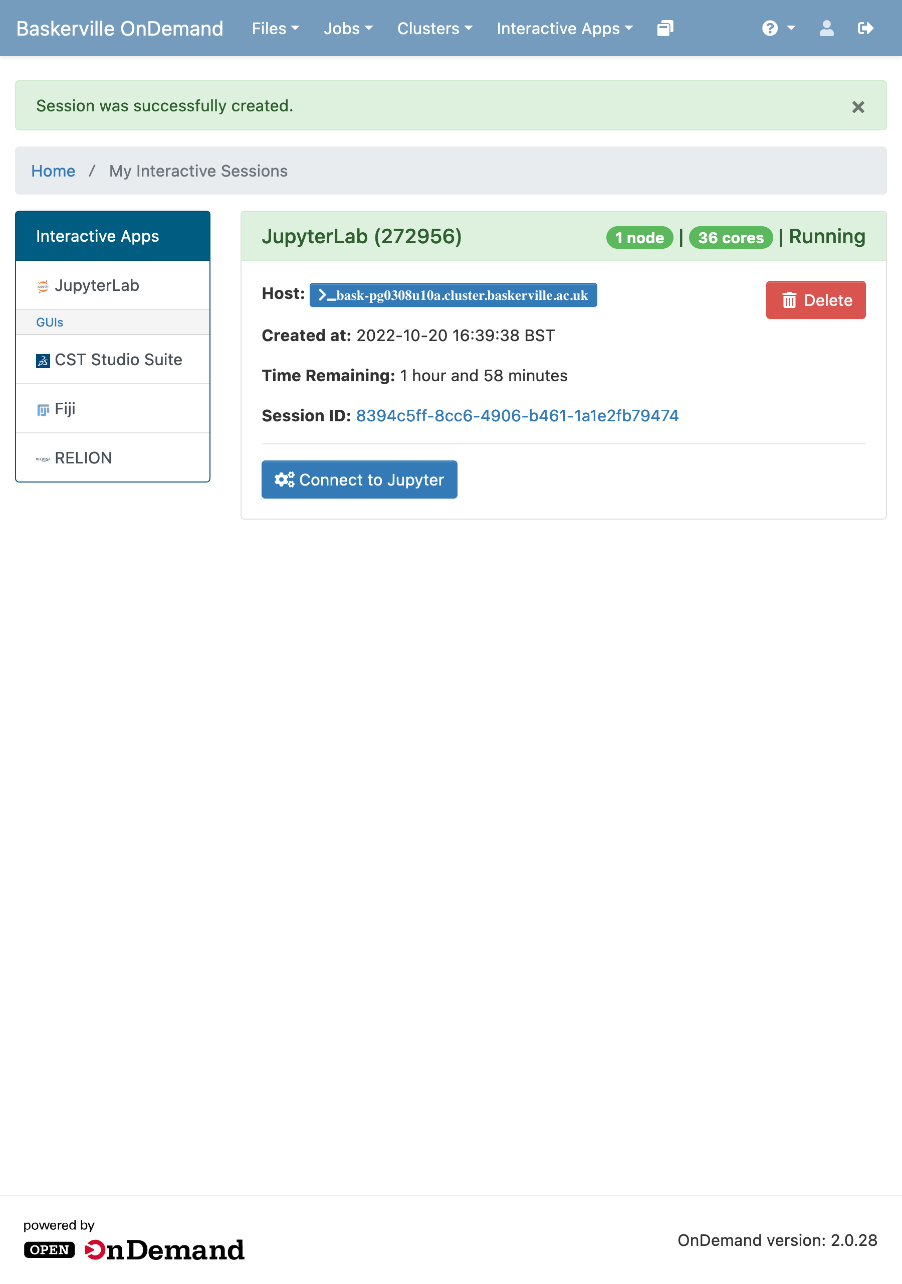
Launch a JupyterLab server
Wait time depends on number of GPUs requested and time requested
Each node has 4 GPUs available, with 36 CPU cores per GPU
Once loaded, click Connect to Jupyter

Slide 15
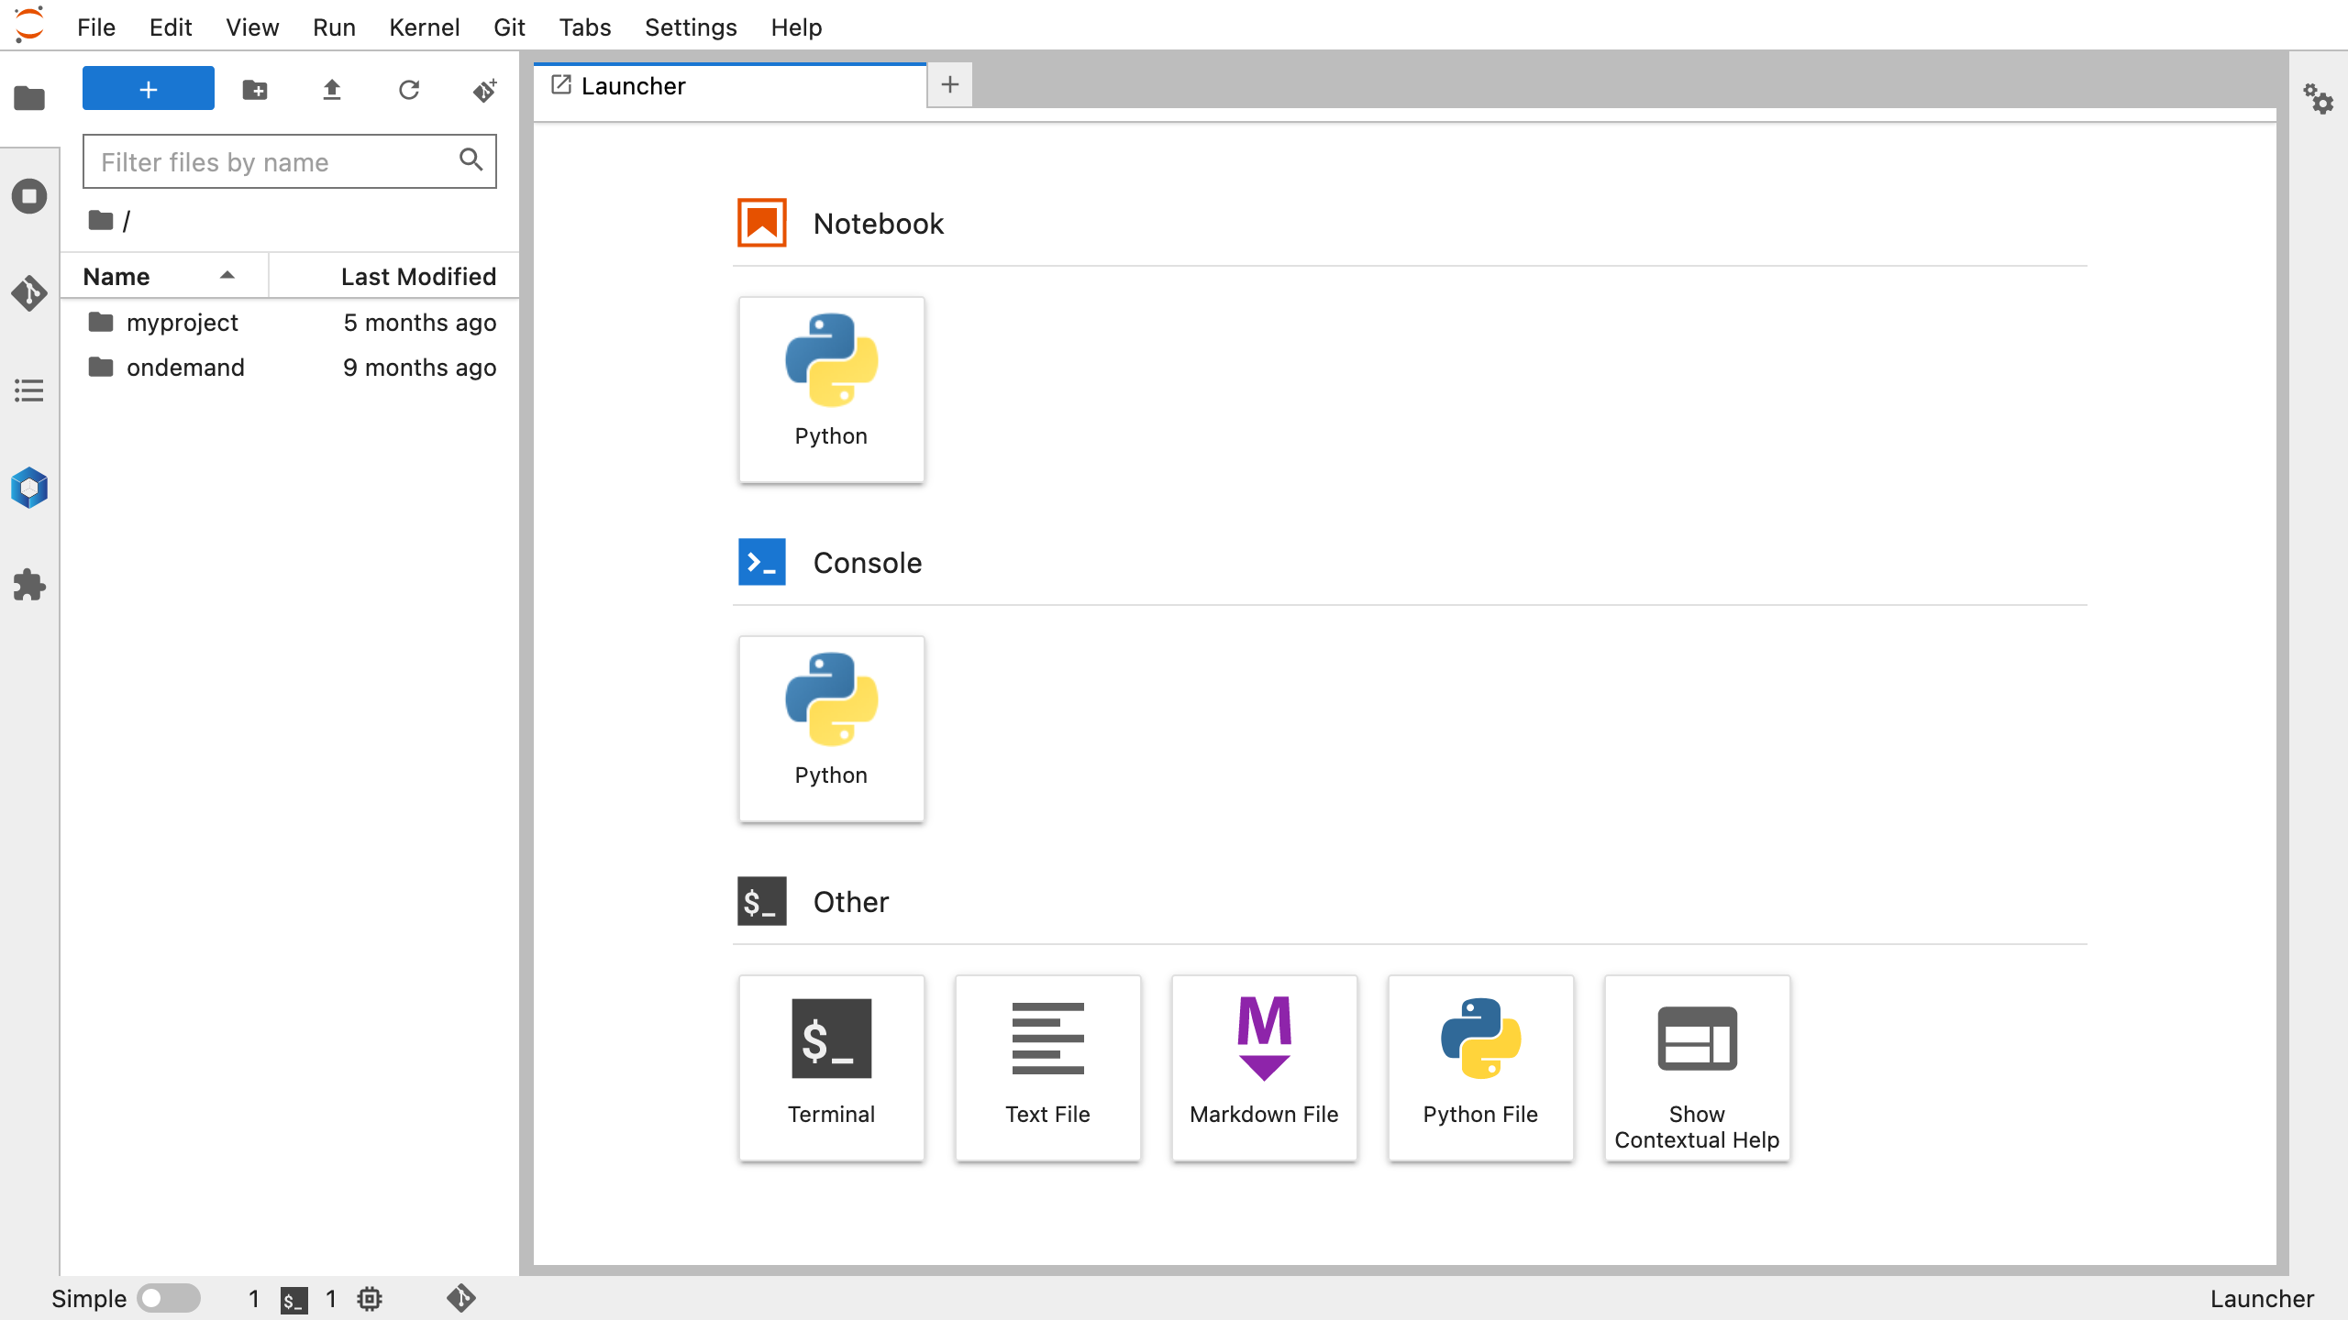
Symlink to project folder
Notes:
home folder can be seen in the filetree viewer on the left-hand side
symlink to myproject folder is available in the filetree
double click to access myproject folder

Slide 16
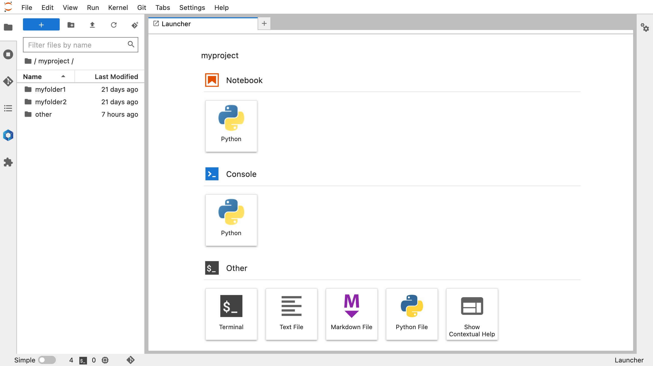
New Jupyter Notebook
Notes:
click button to launch Jupyter Notebook

Slide 17
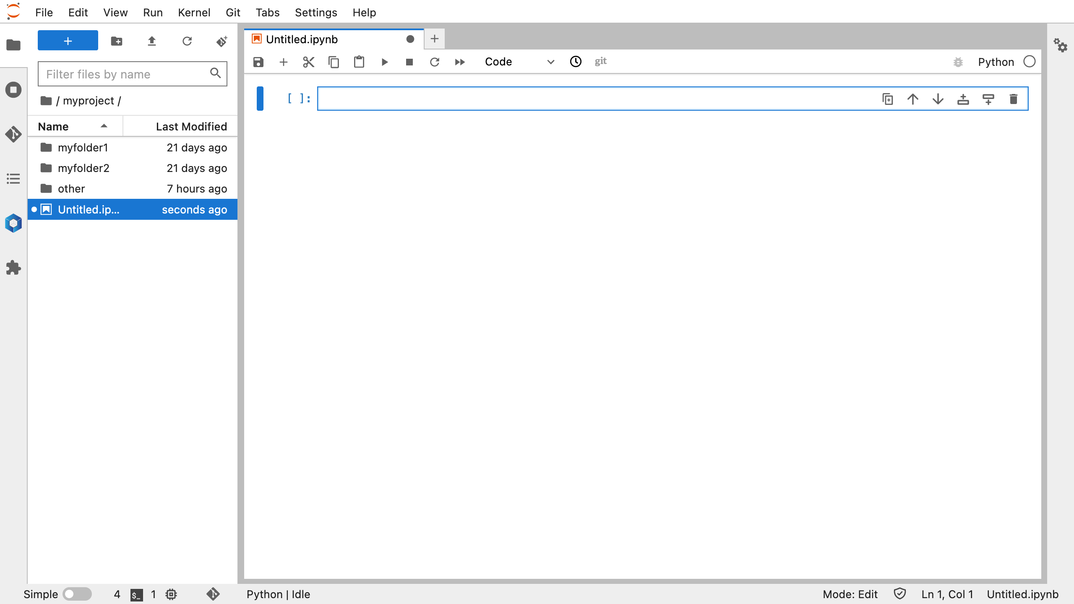
Notes:
Jupyter Notebook is located in ~/myproject/Untitled.ipynb

Slide 18
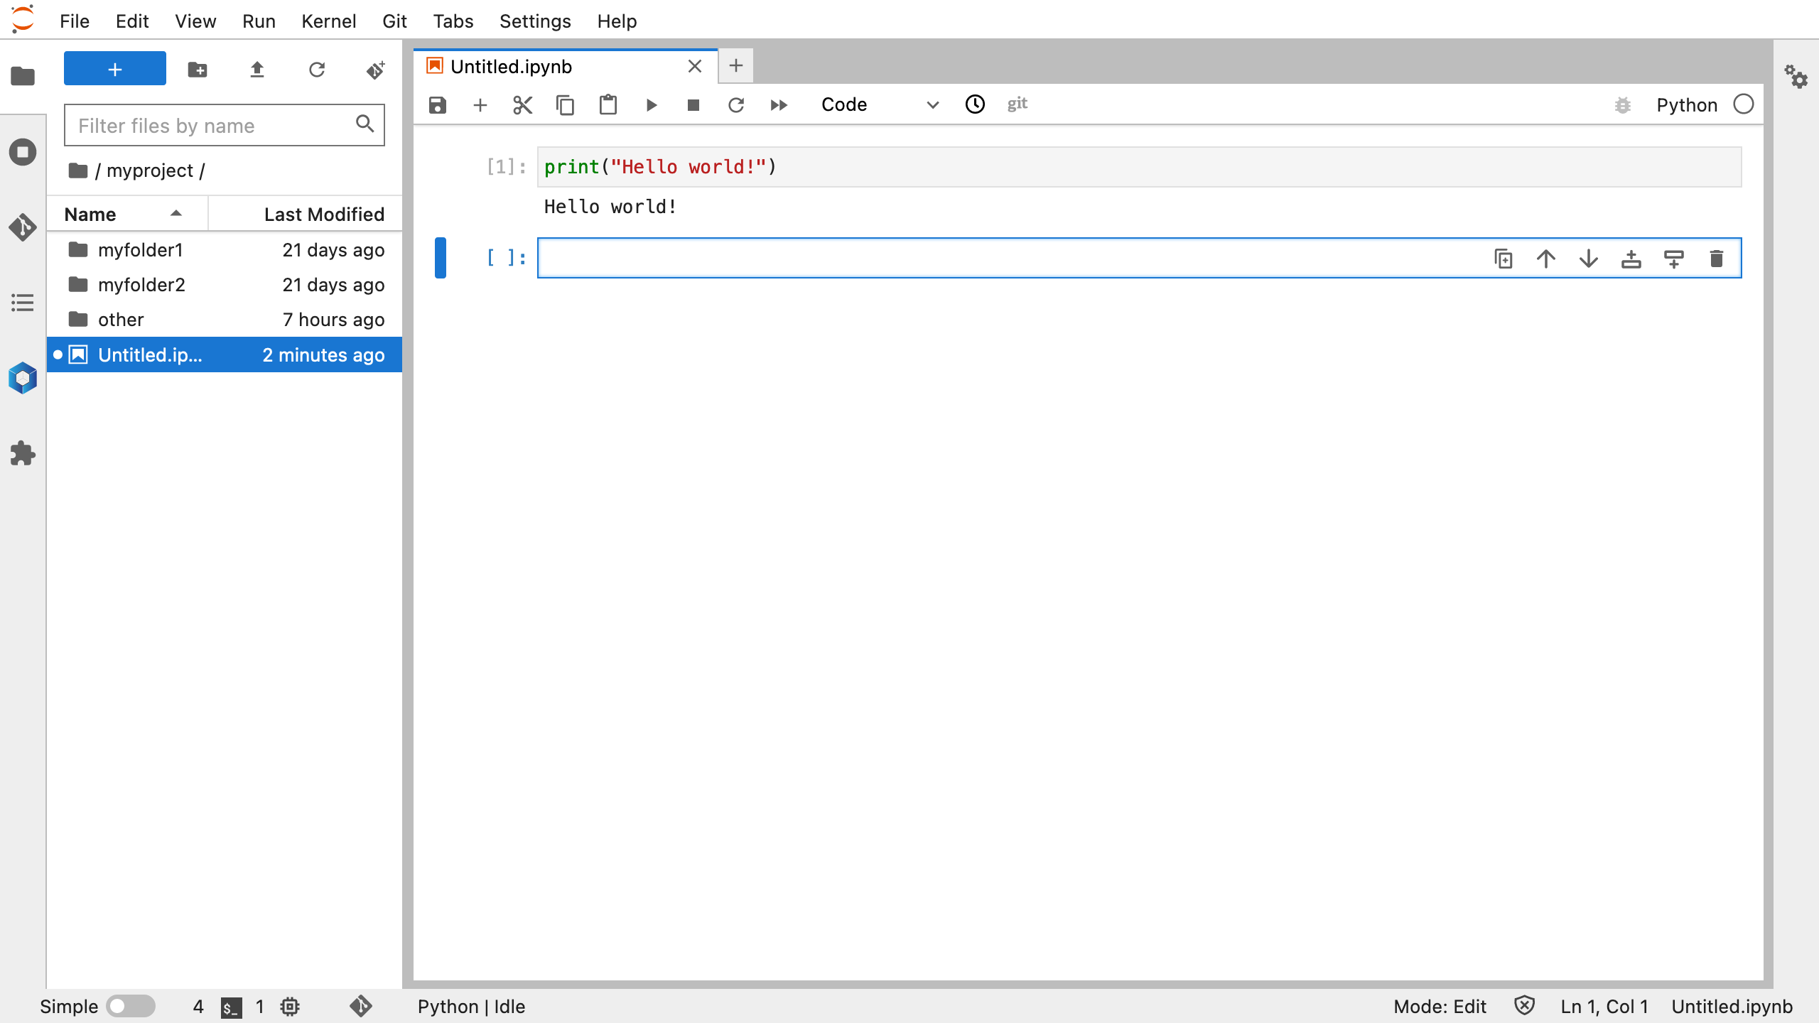
Notes:
Jupyter Notebook is located in ~/myproject/Untitled.ipynb

Slide 19

Save
Remember to save and rename your notebooks
Right click > Rename
Notes:
Remember to save and rename notebook

Slide 20
a) Module Loading
Module applications available include
PyTorch
TensorFlow
Keras
Dask
… and many more!
See apps.baskerville.ac.uk/applications/ for a complete list

Slide 21
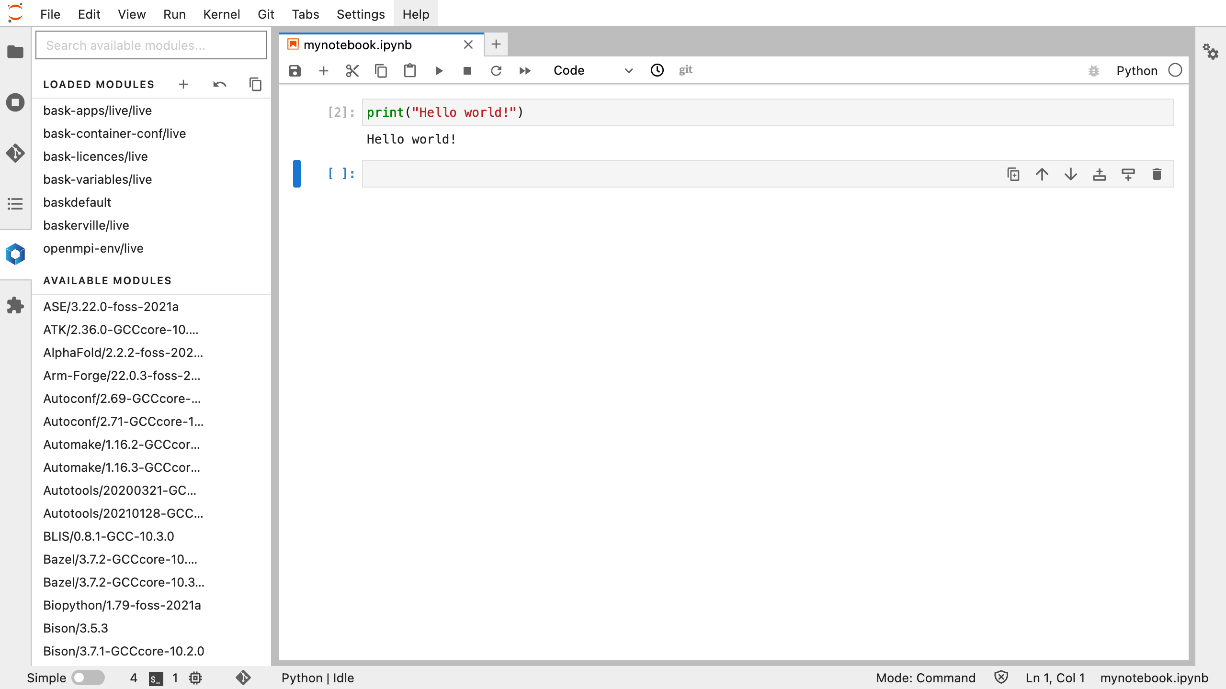
Lmod extension
Loaded Modules appear at the top of the menu
Default environment is currently loaded
Save current collection as default
Notes:
Click blue box to launch Lmod extension window

Slide 22
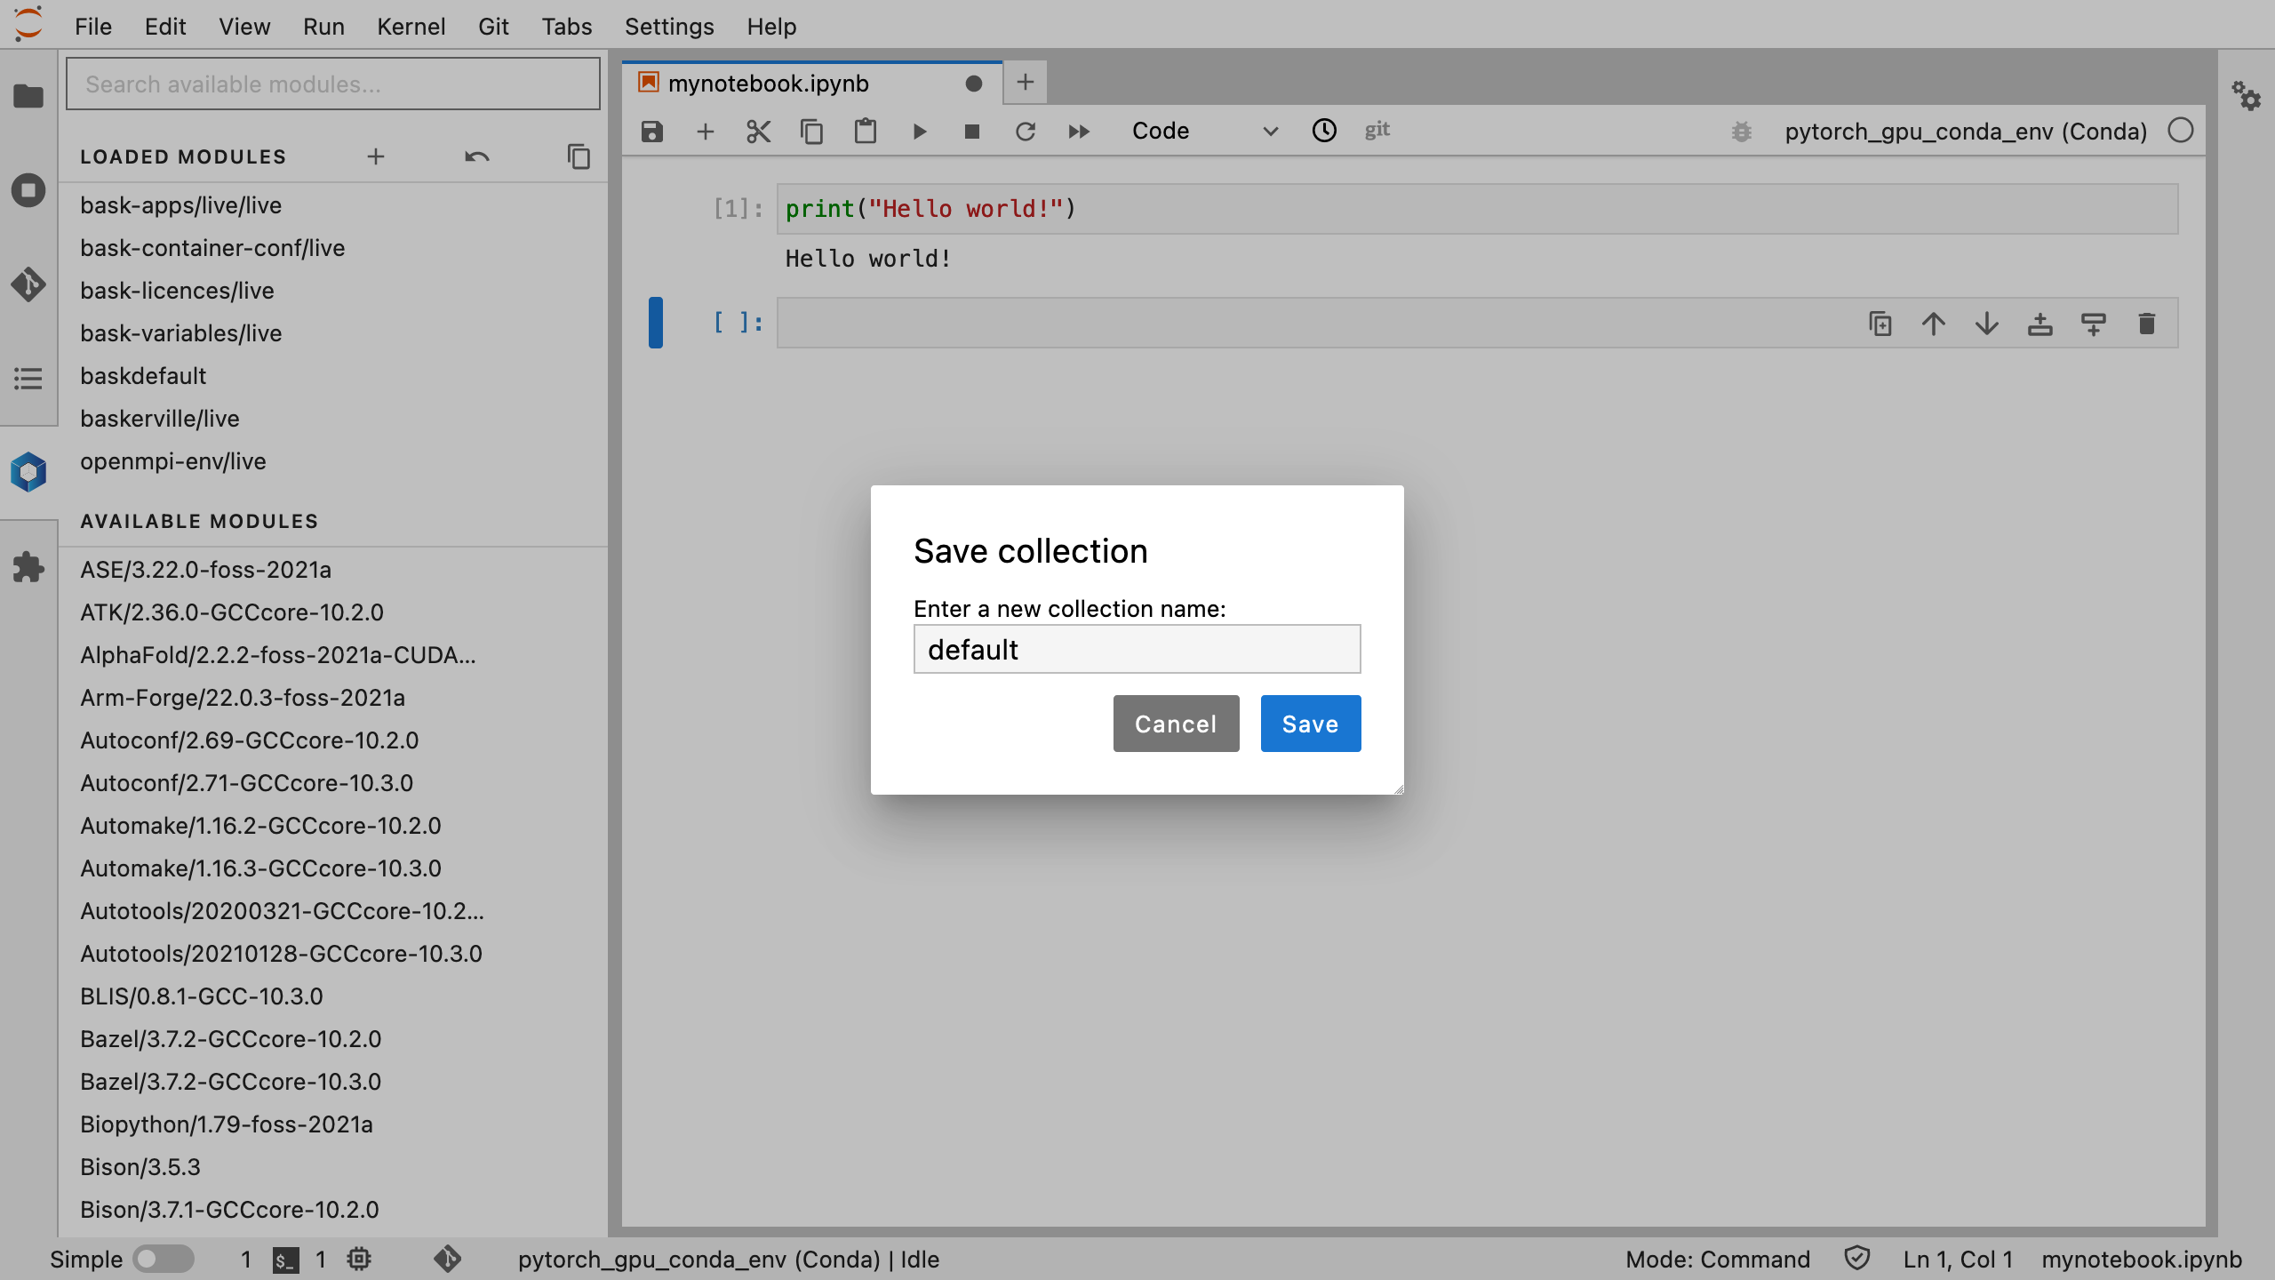
Loaded Modules appear at the top of the menu
Default environment is currently loaded
Save current collection as default
Notes:
Click blue box to launch Lmod extension window
Save the default modules as a collection so that your can restart your environment with this collection later

Slide 23
Lmod extension
Loaded Modules appear at the top of the menu
Default environment is currently loaded
Save current collection as default
Available Modules appear below
Notes:
Click blue box to launch Lmod extension window
Save the default modules as a collection so that your can restart your environment with this collection later

Slide 24
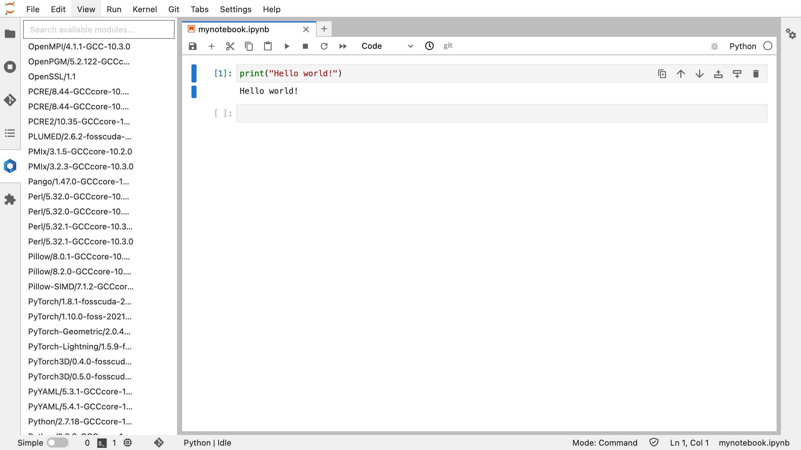
Load PyTorch/1.8.1-fosscuda-2020b
It’s a good idea to load modules built using compatible toolchains, e.g., fosscuda-2020b is compatible with Python 3.8.6 (2020b/GCCore-10.2.0)
https://docs.baskerville.ac.uk/apps/#toolchains
Module loading can take a few minutes
Notes:
Load PyTorch/1.8.1-foss-2021-CUDA-11.3.1 (at date of writing, this is subject to change)
If loading more than one module, then it’s a good idea to load modules built using the same toolchain, so that they are compatible with each other

Slide 25
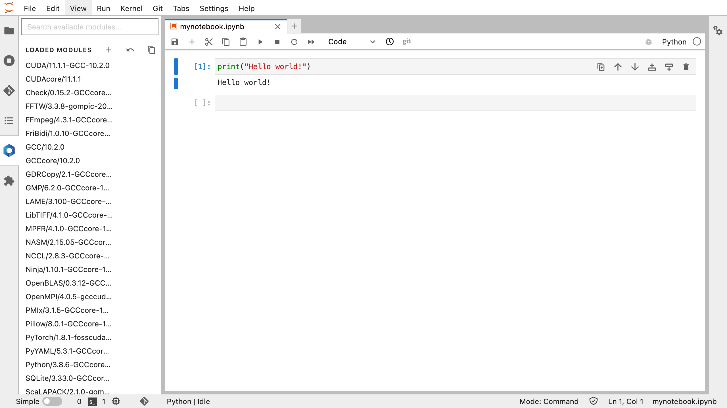
Check modules are loaded in the Loaded Modules section
Restart the kernel (this can also take a few minutes)
Notes:
Module loading takes a while
Once loaded, modules will appear in the `Loaded Modules` section of the Lmod extension
Restart Python kernel to access module

Slide 26
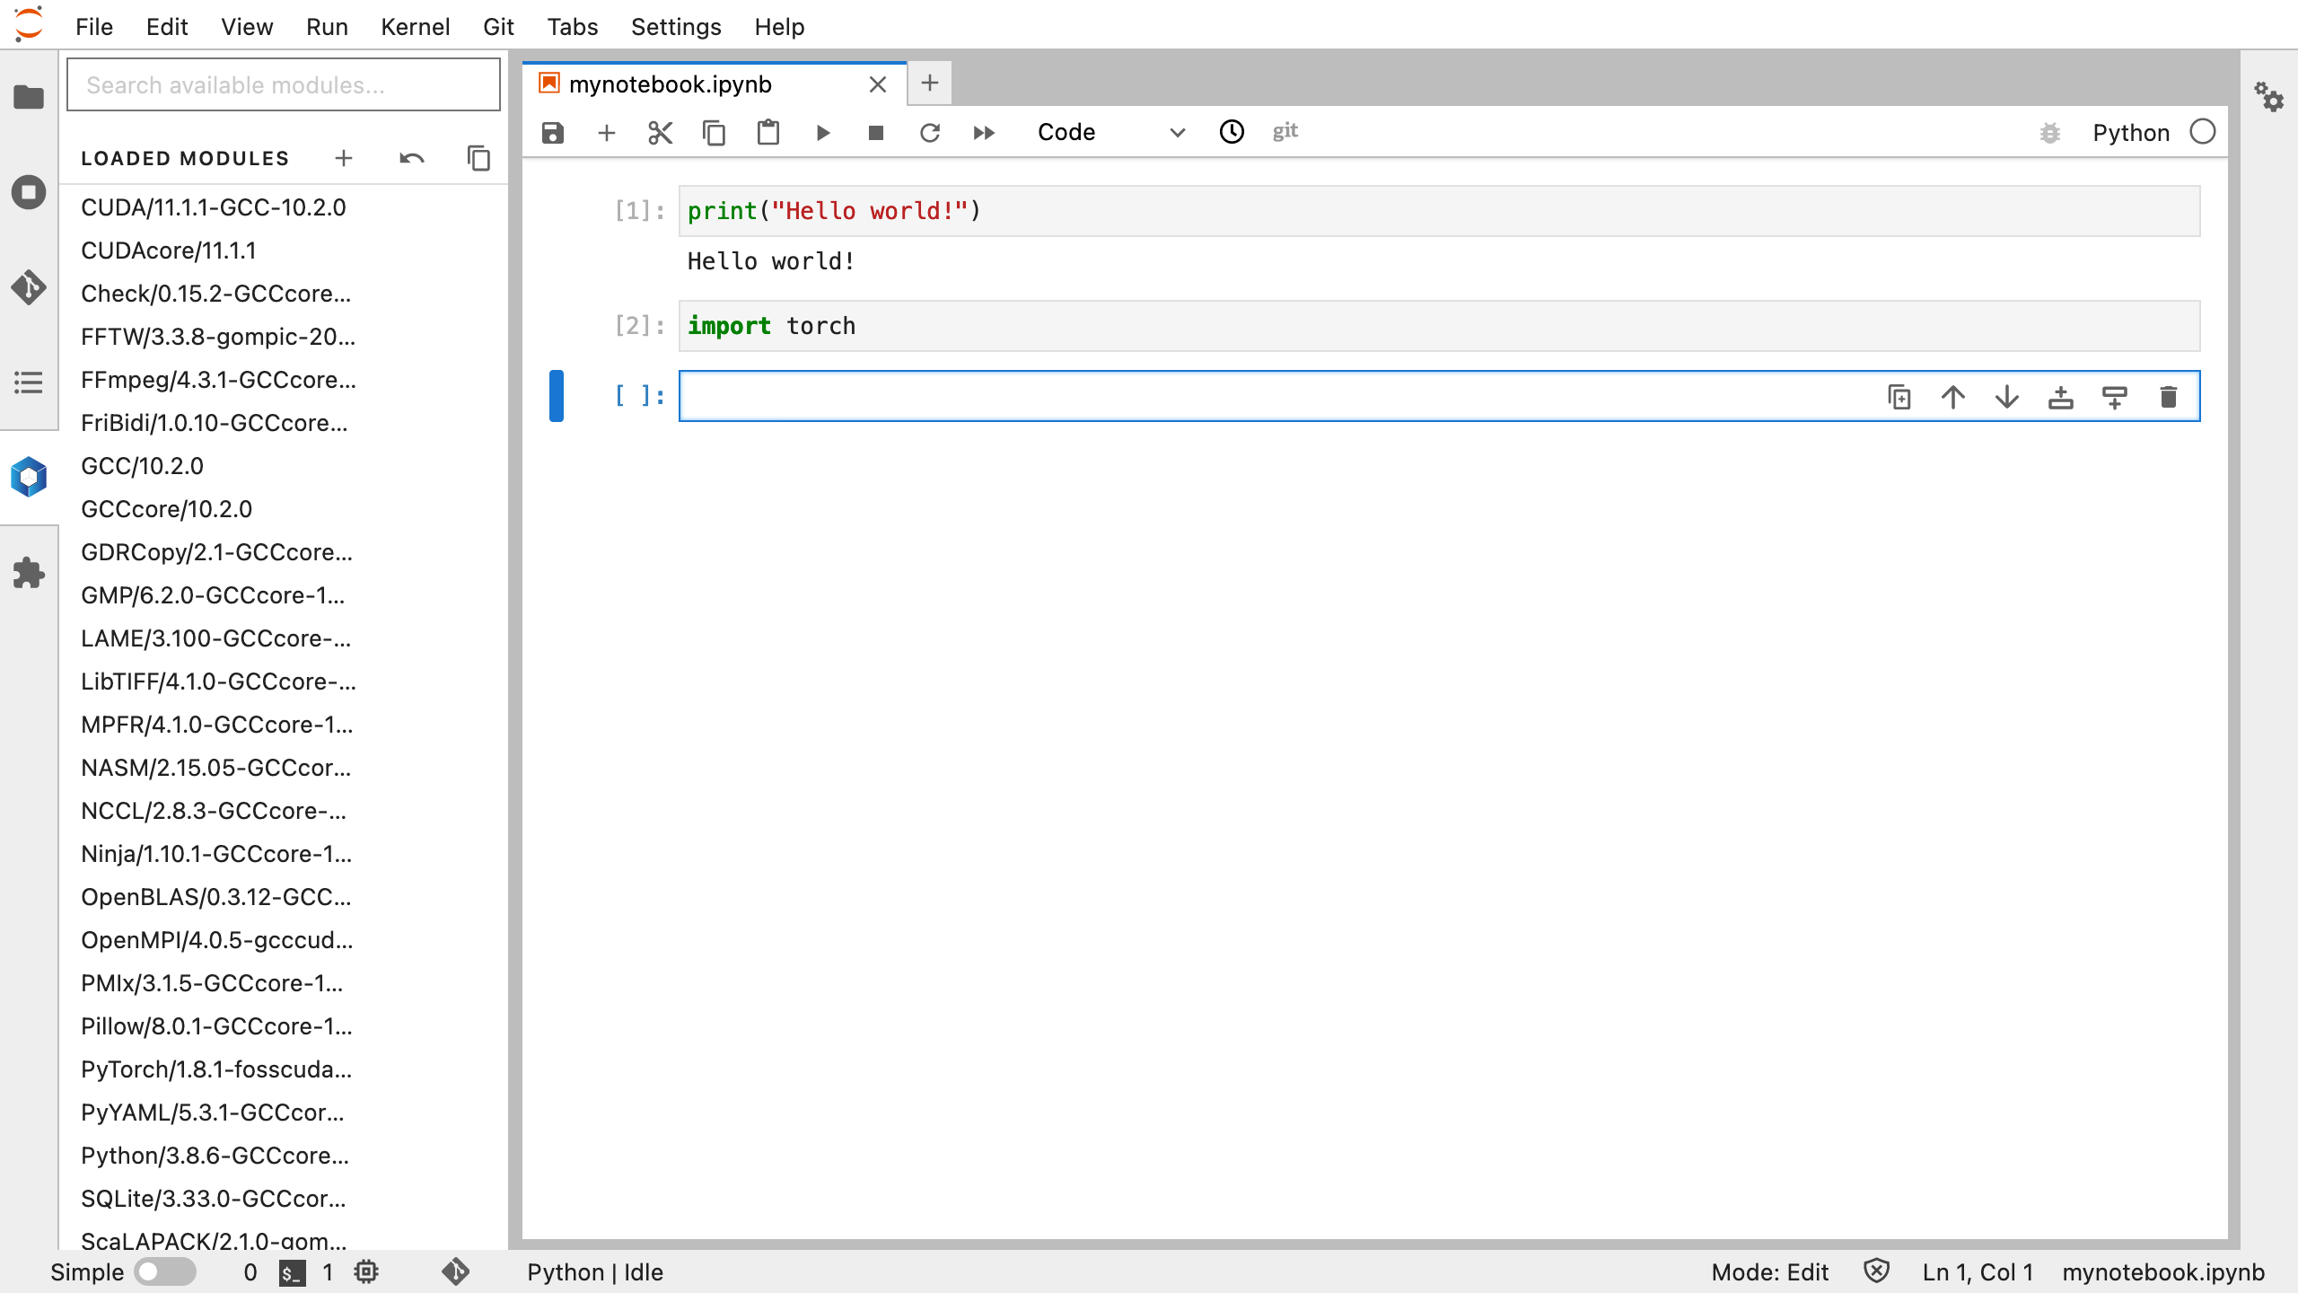
Check modules are loaded in the Loaded Modules section
Restart the kernel (this can also take a few minutes)
Notes:
Module loading takes a while
Once loaded, modules will appear in the `Loaded Modules` section of the Lmod extension
Restart Python kernel to access module
import torch

Slide 27
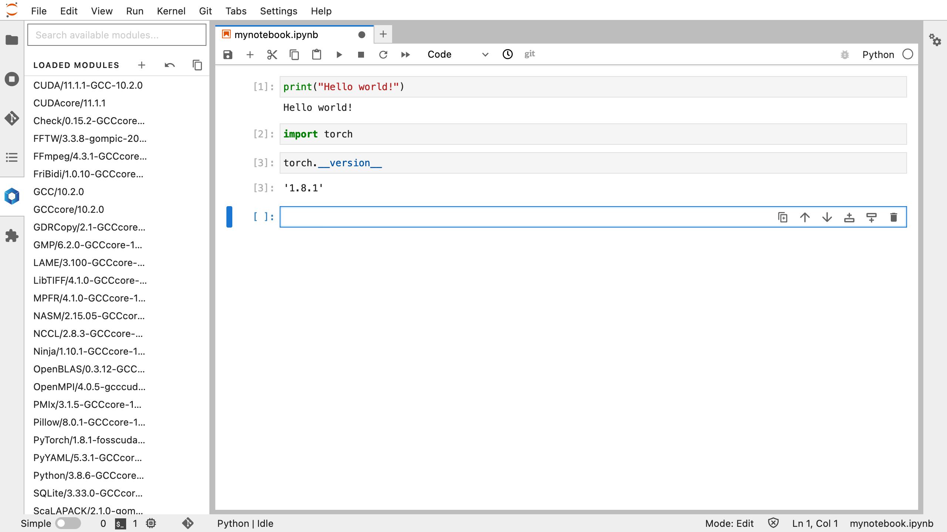
Check modules are loaded in the Loaded Modules section
Restart the kernel (this can also take a few minutes)
Notes:
Module loading takes a while
Once loaded, modules will appear in the `Loaded Modules` section of the Lmod extension
Restart Python kernel to access module
import torch
torch.__version__ to check version number

Slide 28
Restore environment to default
Notes:
Module loading takes a while
Once loaded, modules will appear in the `Loaded Modules` section of the Lmod extension
Restart Python kernel to access module
import torch
torch.__version__ to check version number
Click backwards arrow symbol in Loaded Modules section to restore environment to default

Slide 29
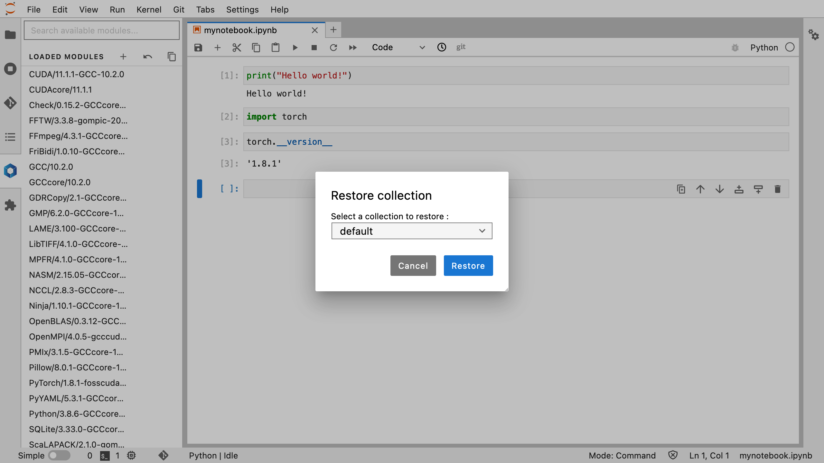
Restore environment to default
Notes:
Module loading takes a while
Once loaded, modules will appear in the `Loaded Modules` section of the Lmod extension
Restart Python kernel to access module
import torch
torch.__version__ to check version number
Click backwards arrow symbol in Loaded Modules section to restore environment to default

Slide 30
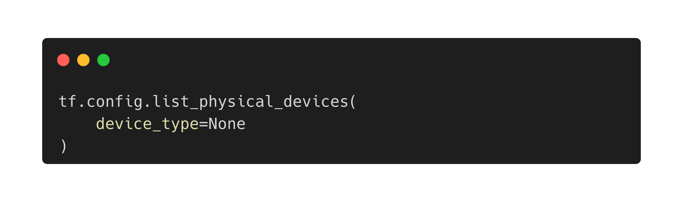
Your turn
https://github.com/baskerville-hpc/baskerville-portal
Restore default environment and restart kernel
Module load TensorFlow
import tensorflow as tf
Check the software version number with tf.__version__
Query visible GPU devices with the command

Slide 31
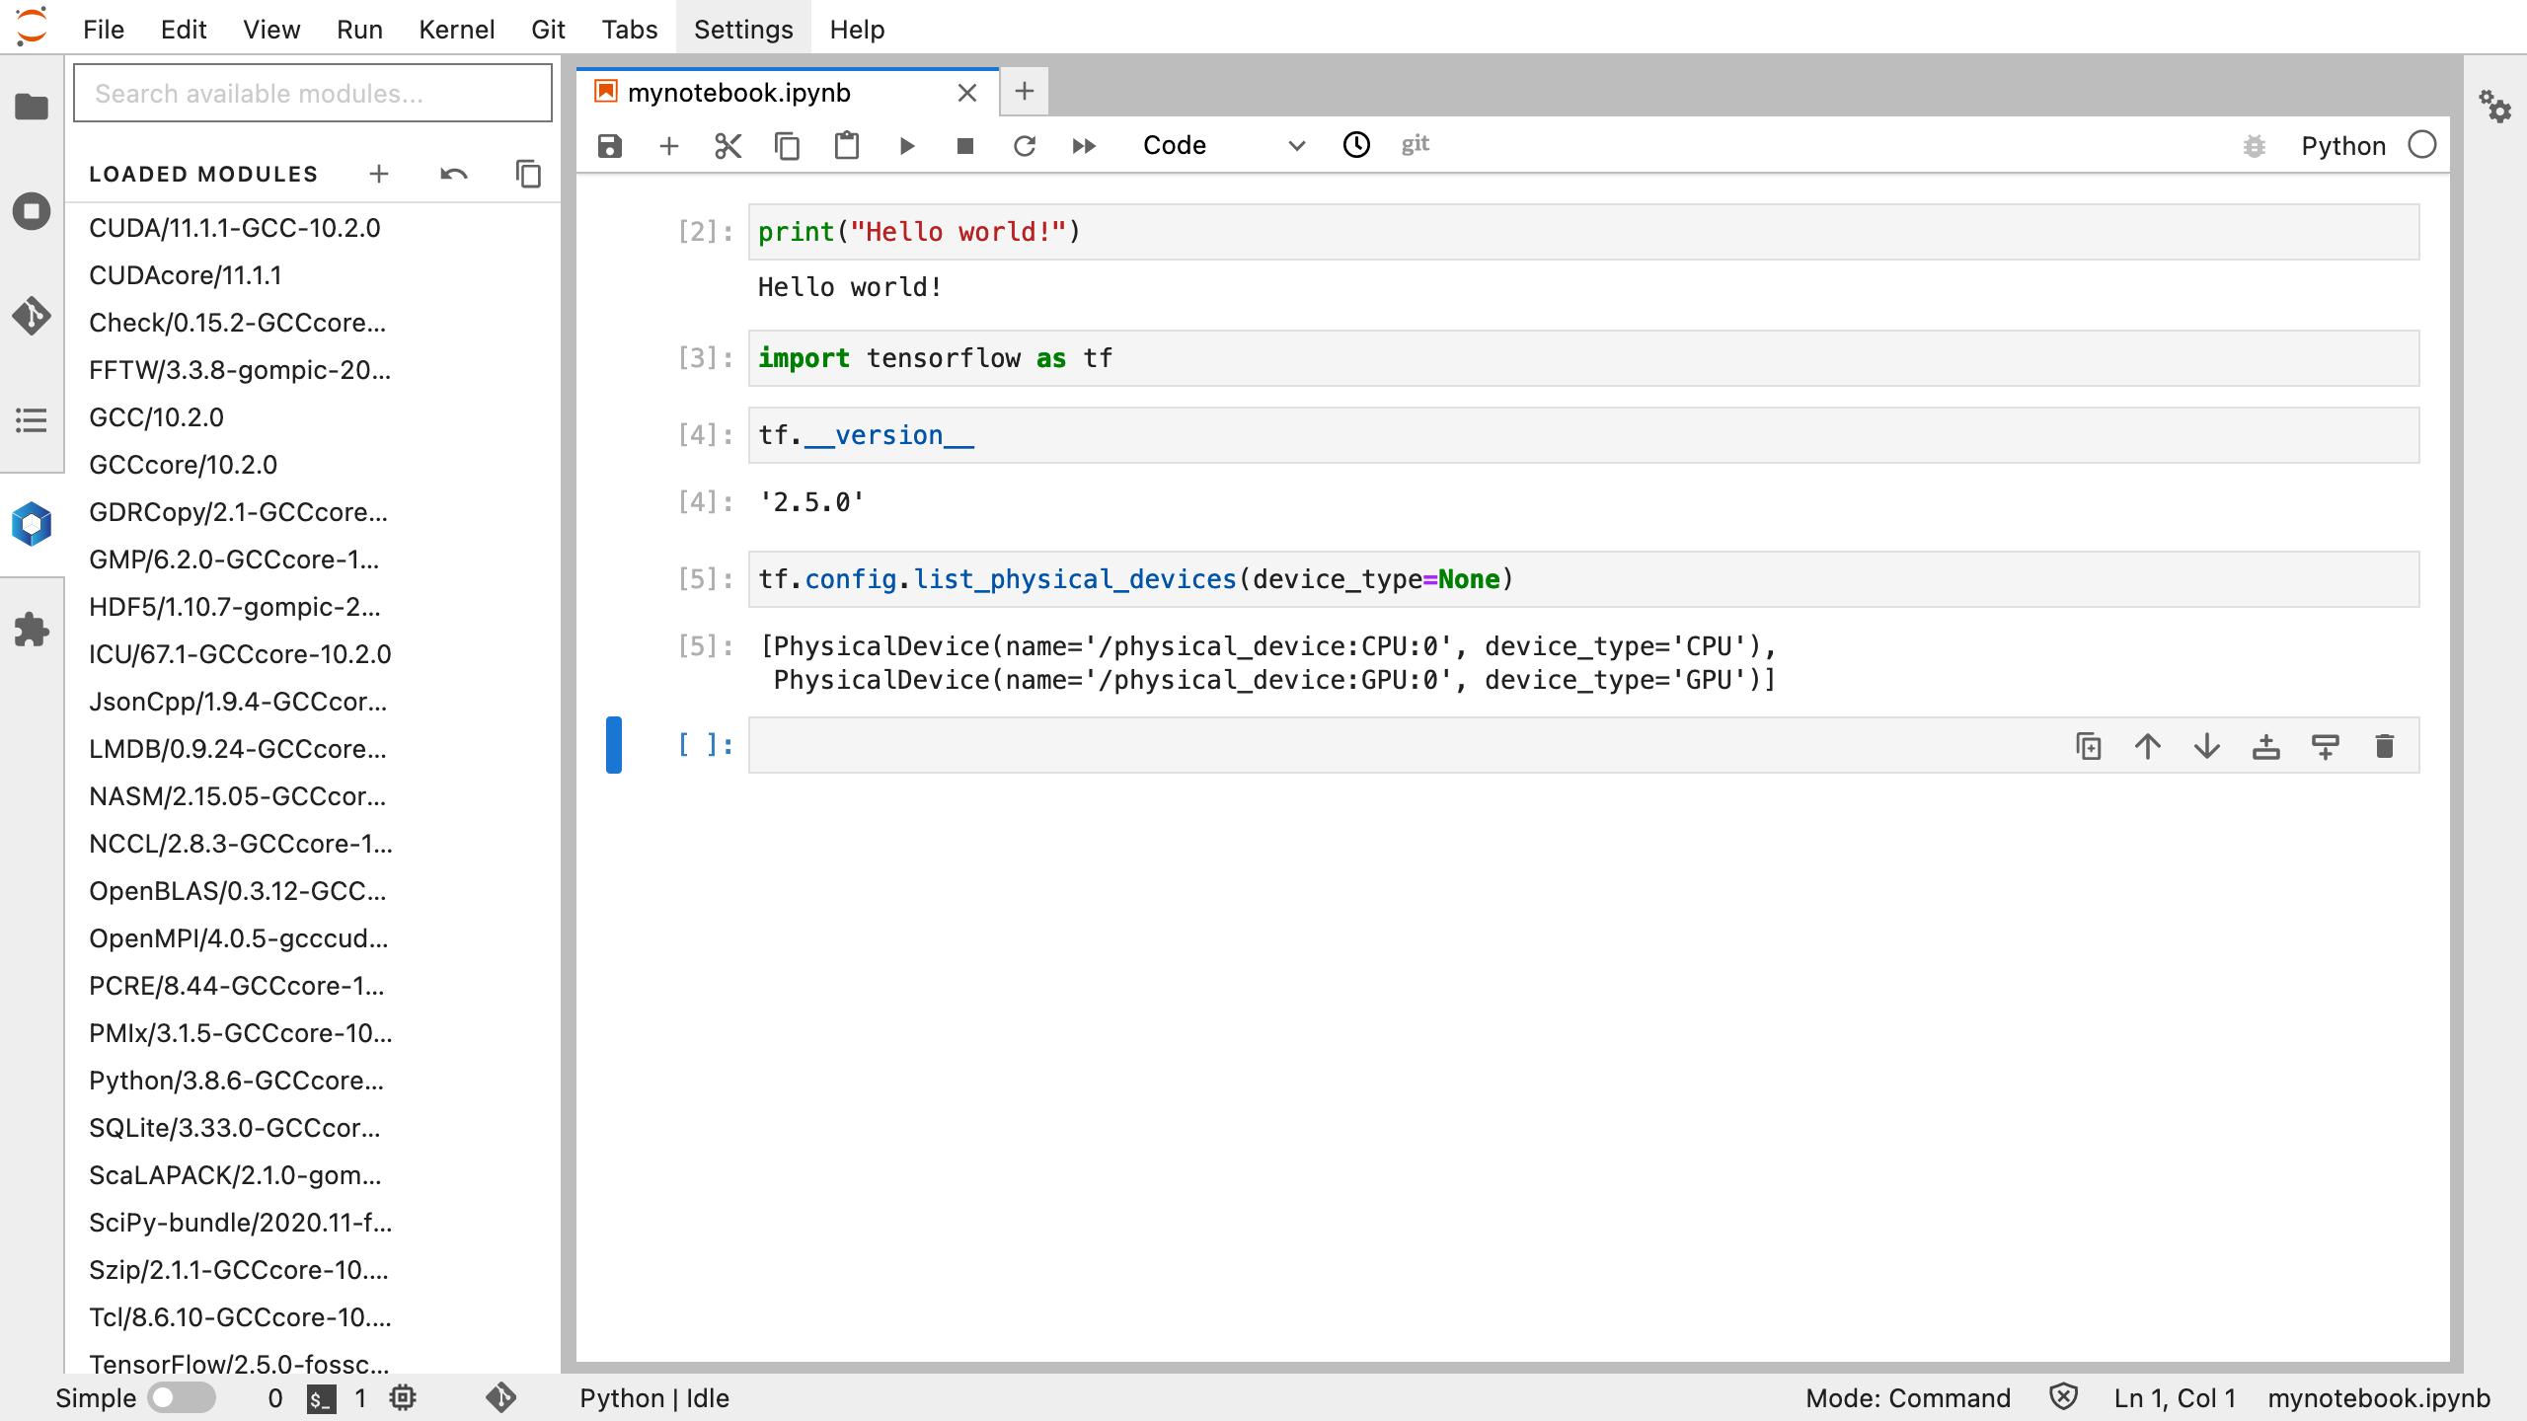

Slide 32
b) Conda Environments
Conda is a package and environment manager for Python
Steps to create a Conda Environment for JupyterLab:
Create a Conda environment in your project folder using a batch script in the Terminal
Relaunch the JupyterLab server to load the new Conda kernel
(Optional) Use the same JupyterLab session to modify the environment
Notes:
Conda environments can be quite large, so create them in a project folder rather than your home folder

Slide 33
3. JupyterLab
b) Conda Environments
(i) Create your Conda Environment

Slide 34
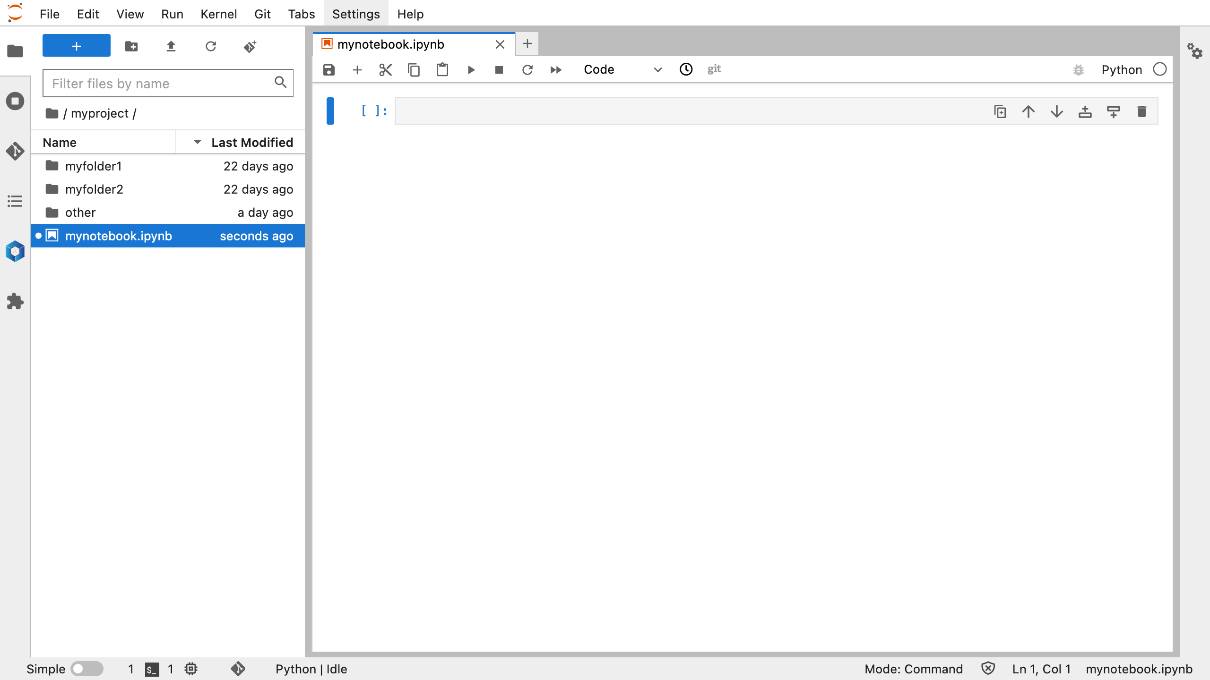
Notes:
Right click > New File
Name file conda-create.sh and double-click to open
This opens a text editor in which you can write a batch script to create your conda environment

Slide 35
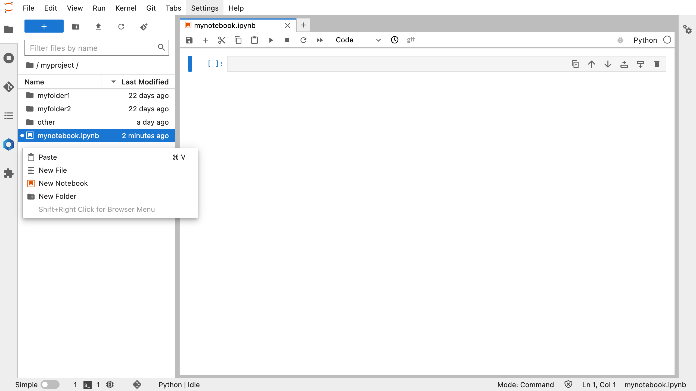
Right click > New File
Notes:
Right click > New File
Name file conda-create.sh and double-click to open
This opens a text editor in which you can write a batch script to create your conda environment

Slide 36
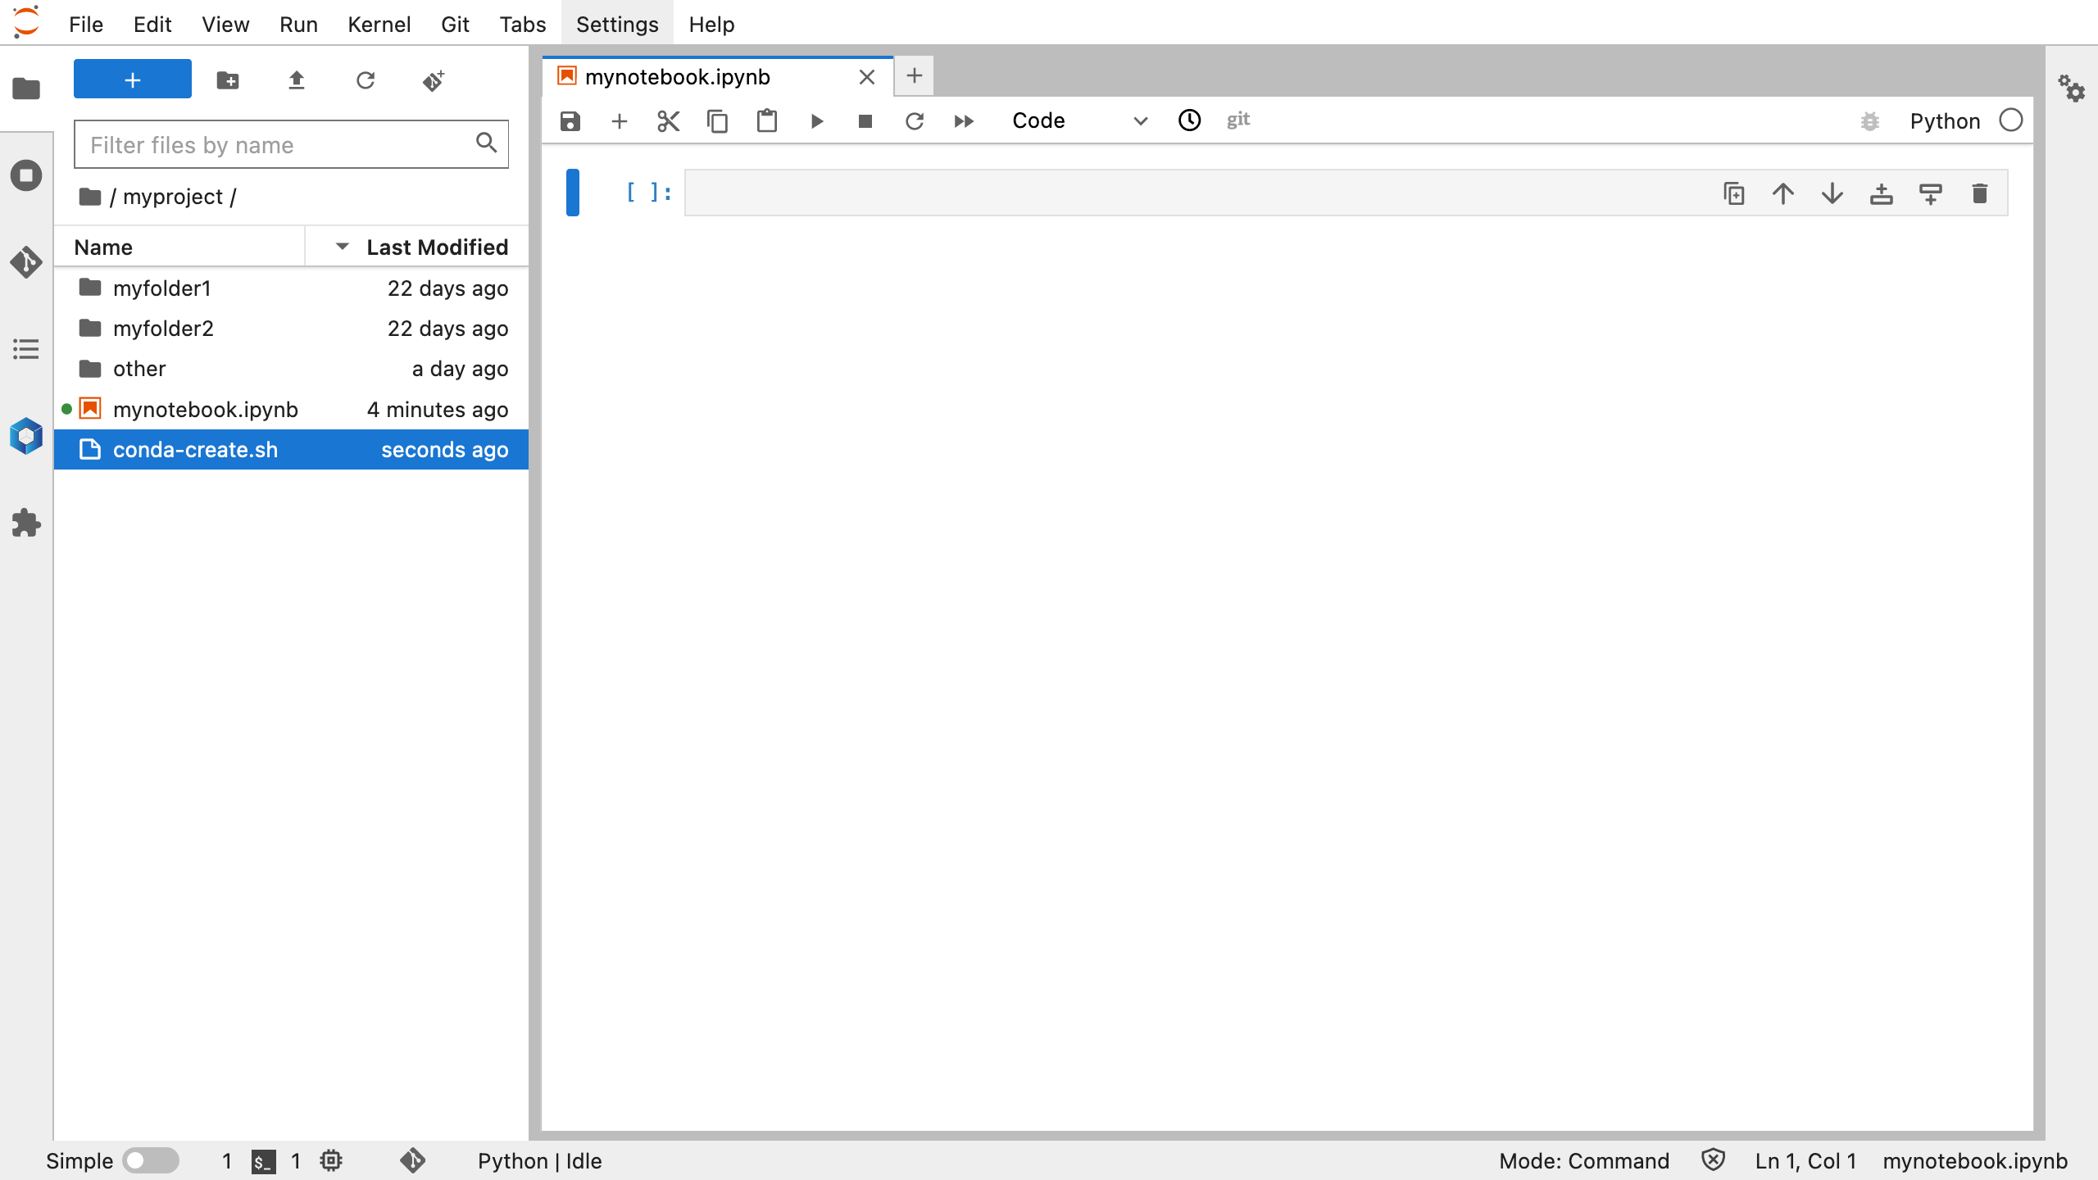
Right click > New File
Name file conda-create.sh and double-click to open
Notes:
Right click > New File
Name file conda-create.sh and double-click to open
This opens a text editor in which you can write a batch script to create your conda environment

Slide 37
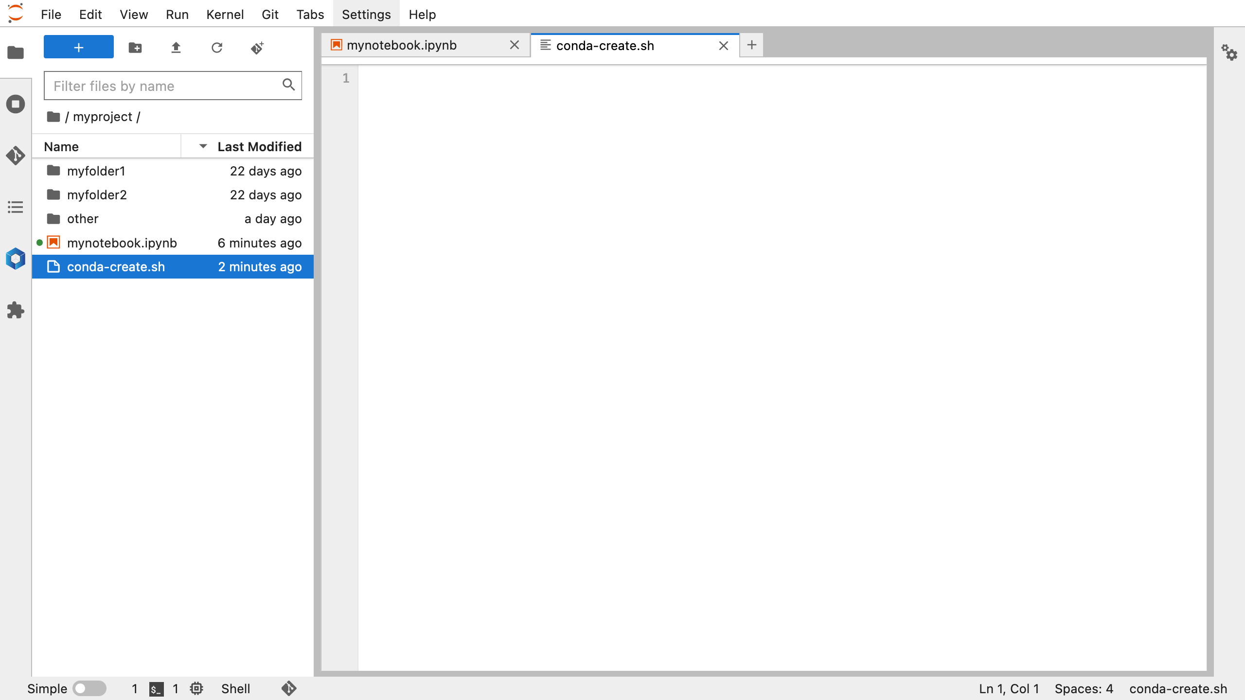
Right click > New File
Name file conda-create.sh and double-click to open
This opens a text editor in which you can write a batch script to create your conda environment
Notes:
Right click > New File
Name file conda-create.sh and double-click to open
This opens a text editor in which you can write a batch script to create your conda environment

Slide 38
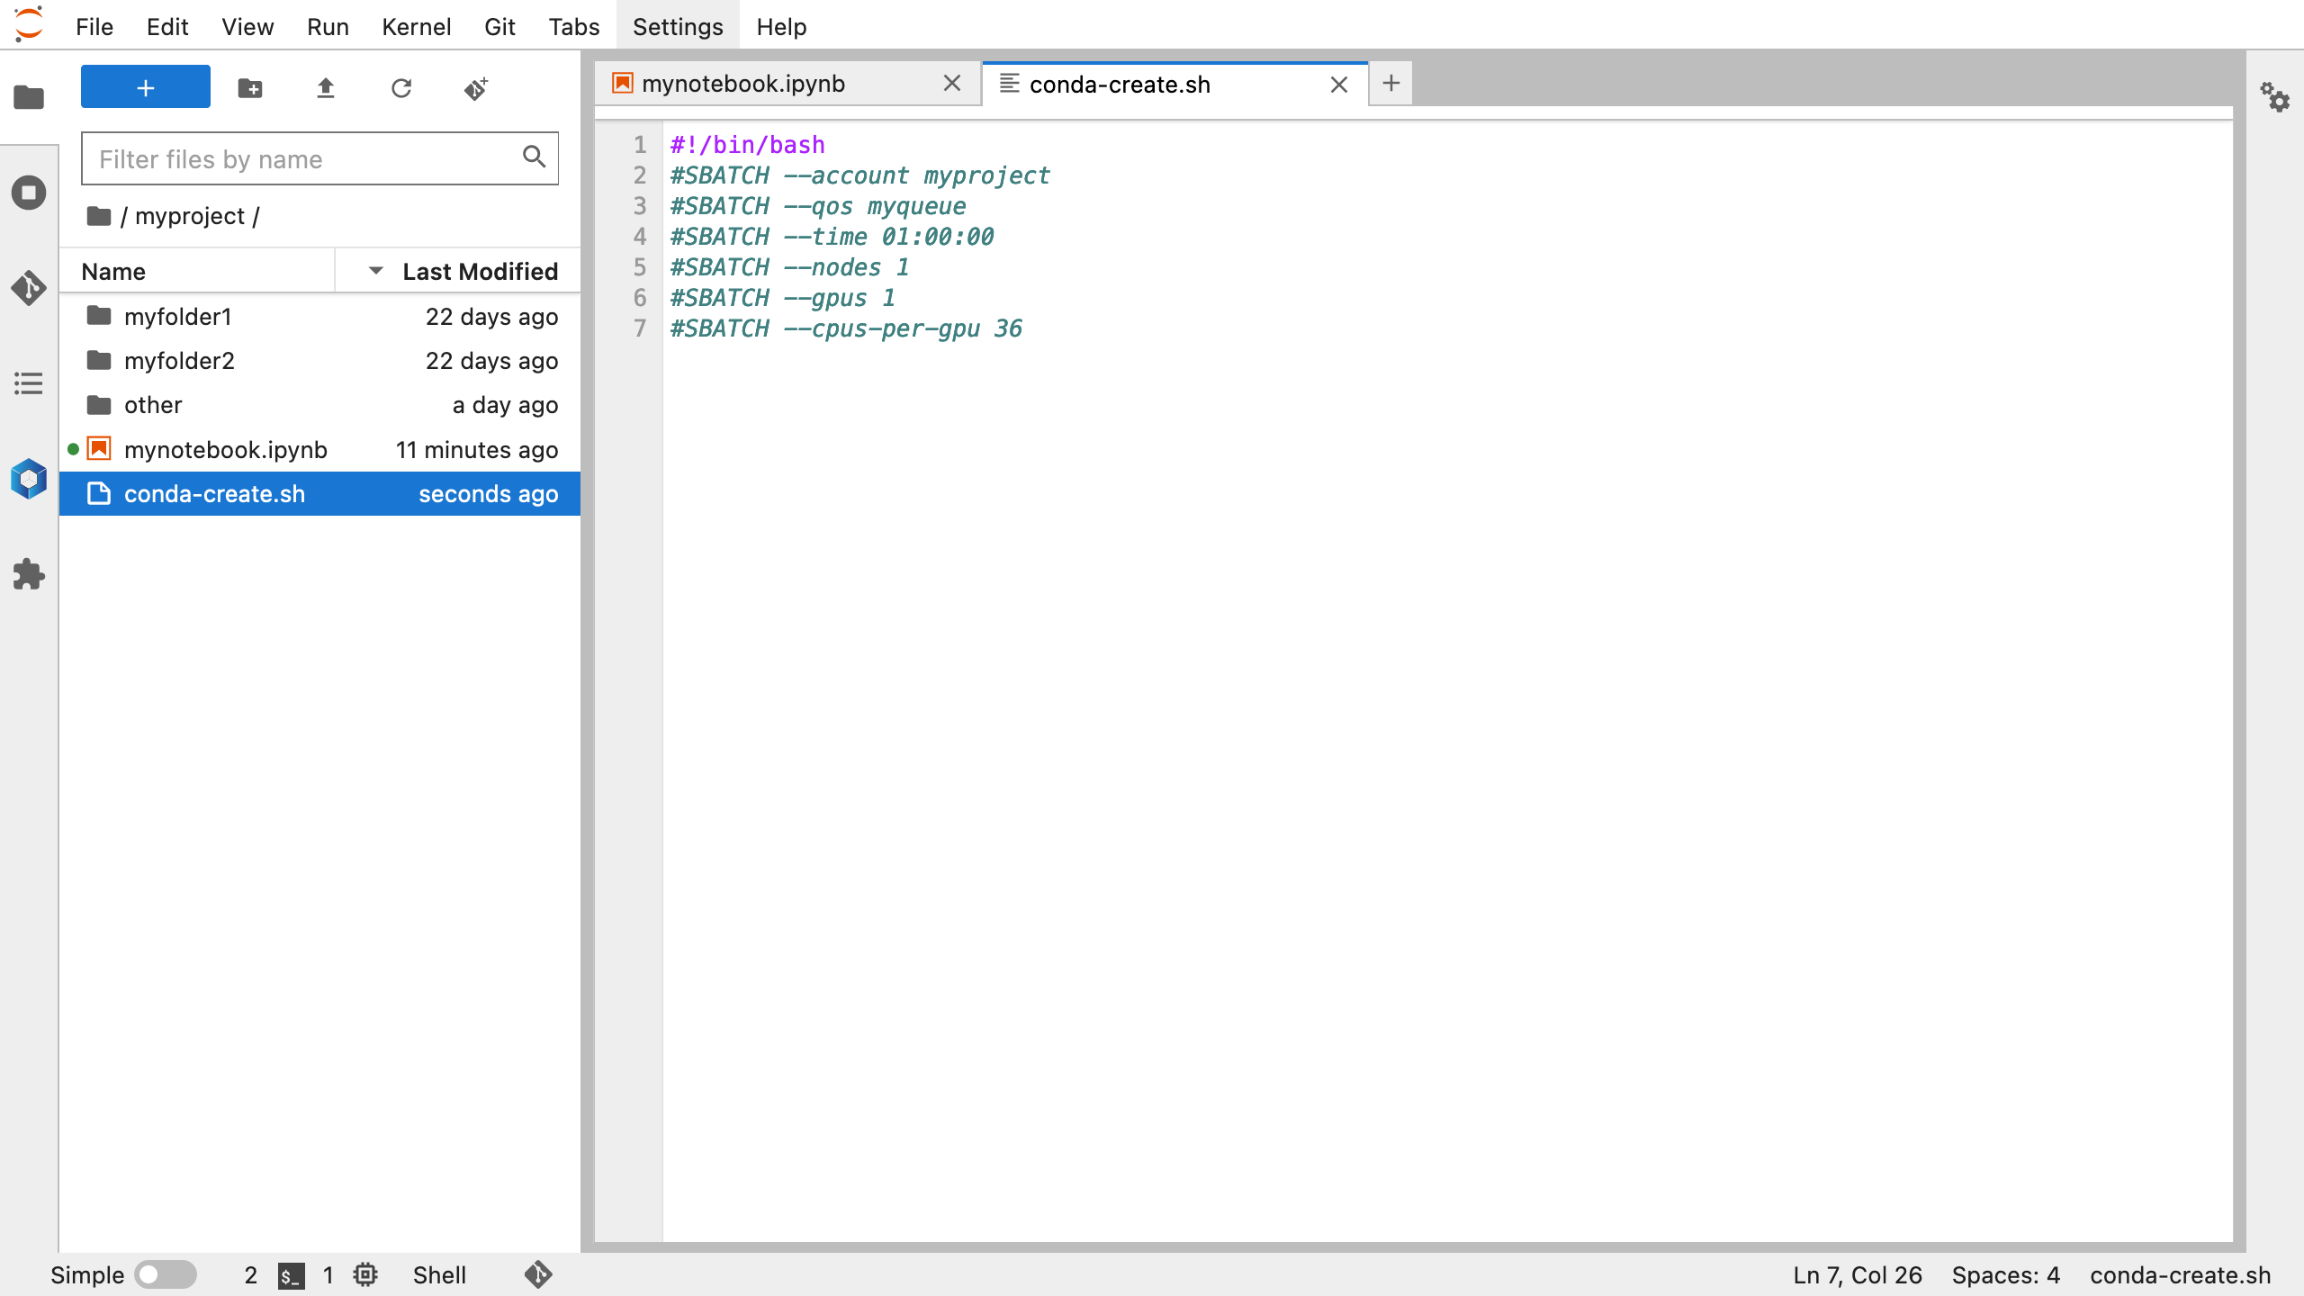
account and qos details can be double checked with my_baskerville command in the Terminal
request a modest amount of time for an increased chance of your job starting straight away
1 node has 4 GPUs and 144 CPU cores, therefore 144/4 = 36 cores and 4/4 = 1 GPU are the minimum resources available to build the environment (even if we requested less cores, this still takes 1 GPU out of service due to distribution of system architecture)
Notes:
write a batch job to build conda environment
account and qos details can be double checked with my_baskerville command in the Terminal
request a modest amount of time for increased chance of job scheduling straight away
1 node has 4 GPUs and 144 CPU cores, therefore 144/4 – 36 cores and 4/4=1 GPU are the minimum resources used to build the environment (even if we requested less cores, this still takes 1 GPU out of service due to distribution of system architecture)

Slide 39
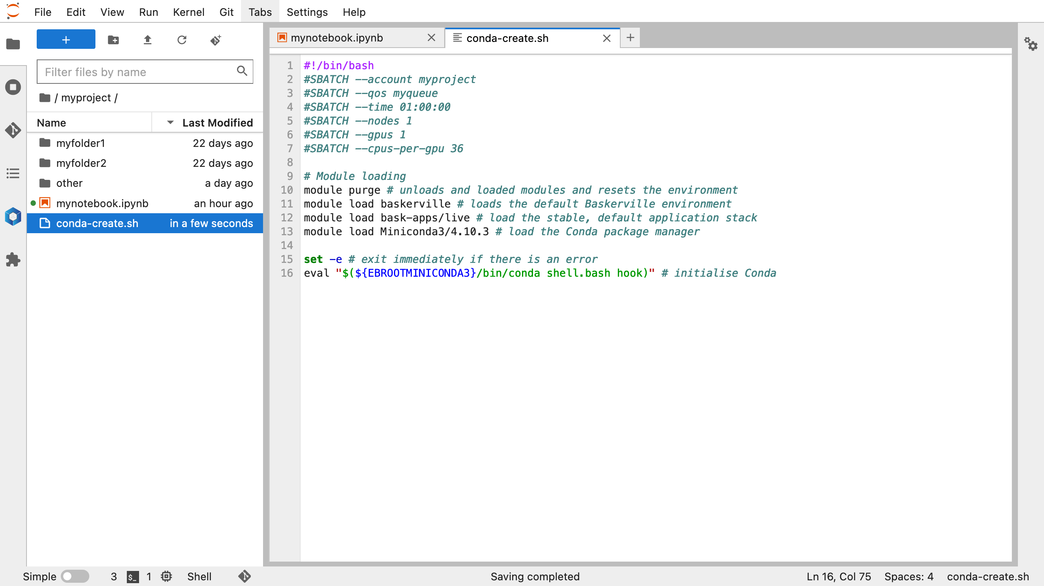
Notes:
module purge – unloads loaded modules and resets the environment
module load baskerville – loads the defaul Baskerville environment
module load bask-apps/live – load the stable, default application stack
module load Miniconda – load the conda package manager
set –e - exit bash script immediately if there is an error
eval ”$({EBOOTMINICONDA3}/bin/conda shell.bash hook)” – initialise conda

Slide 40
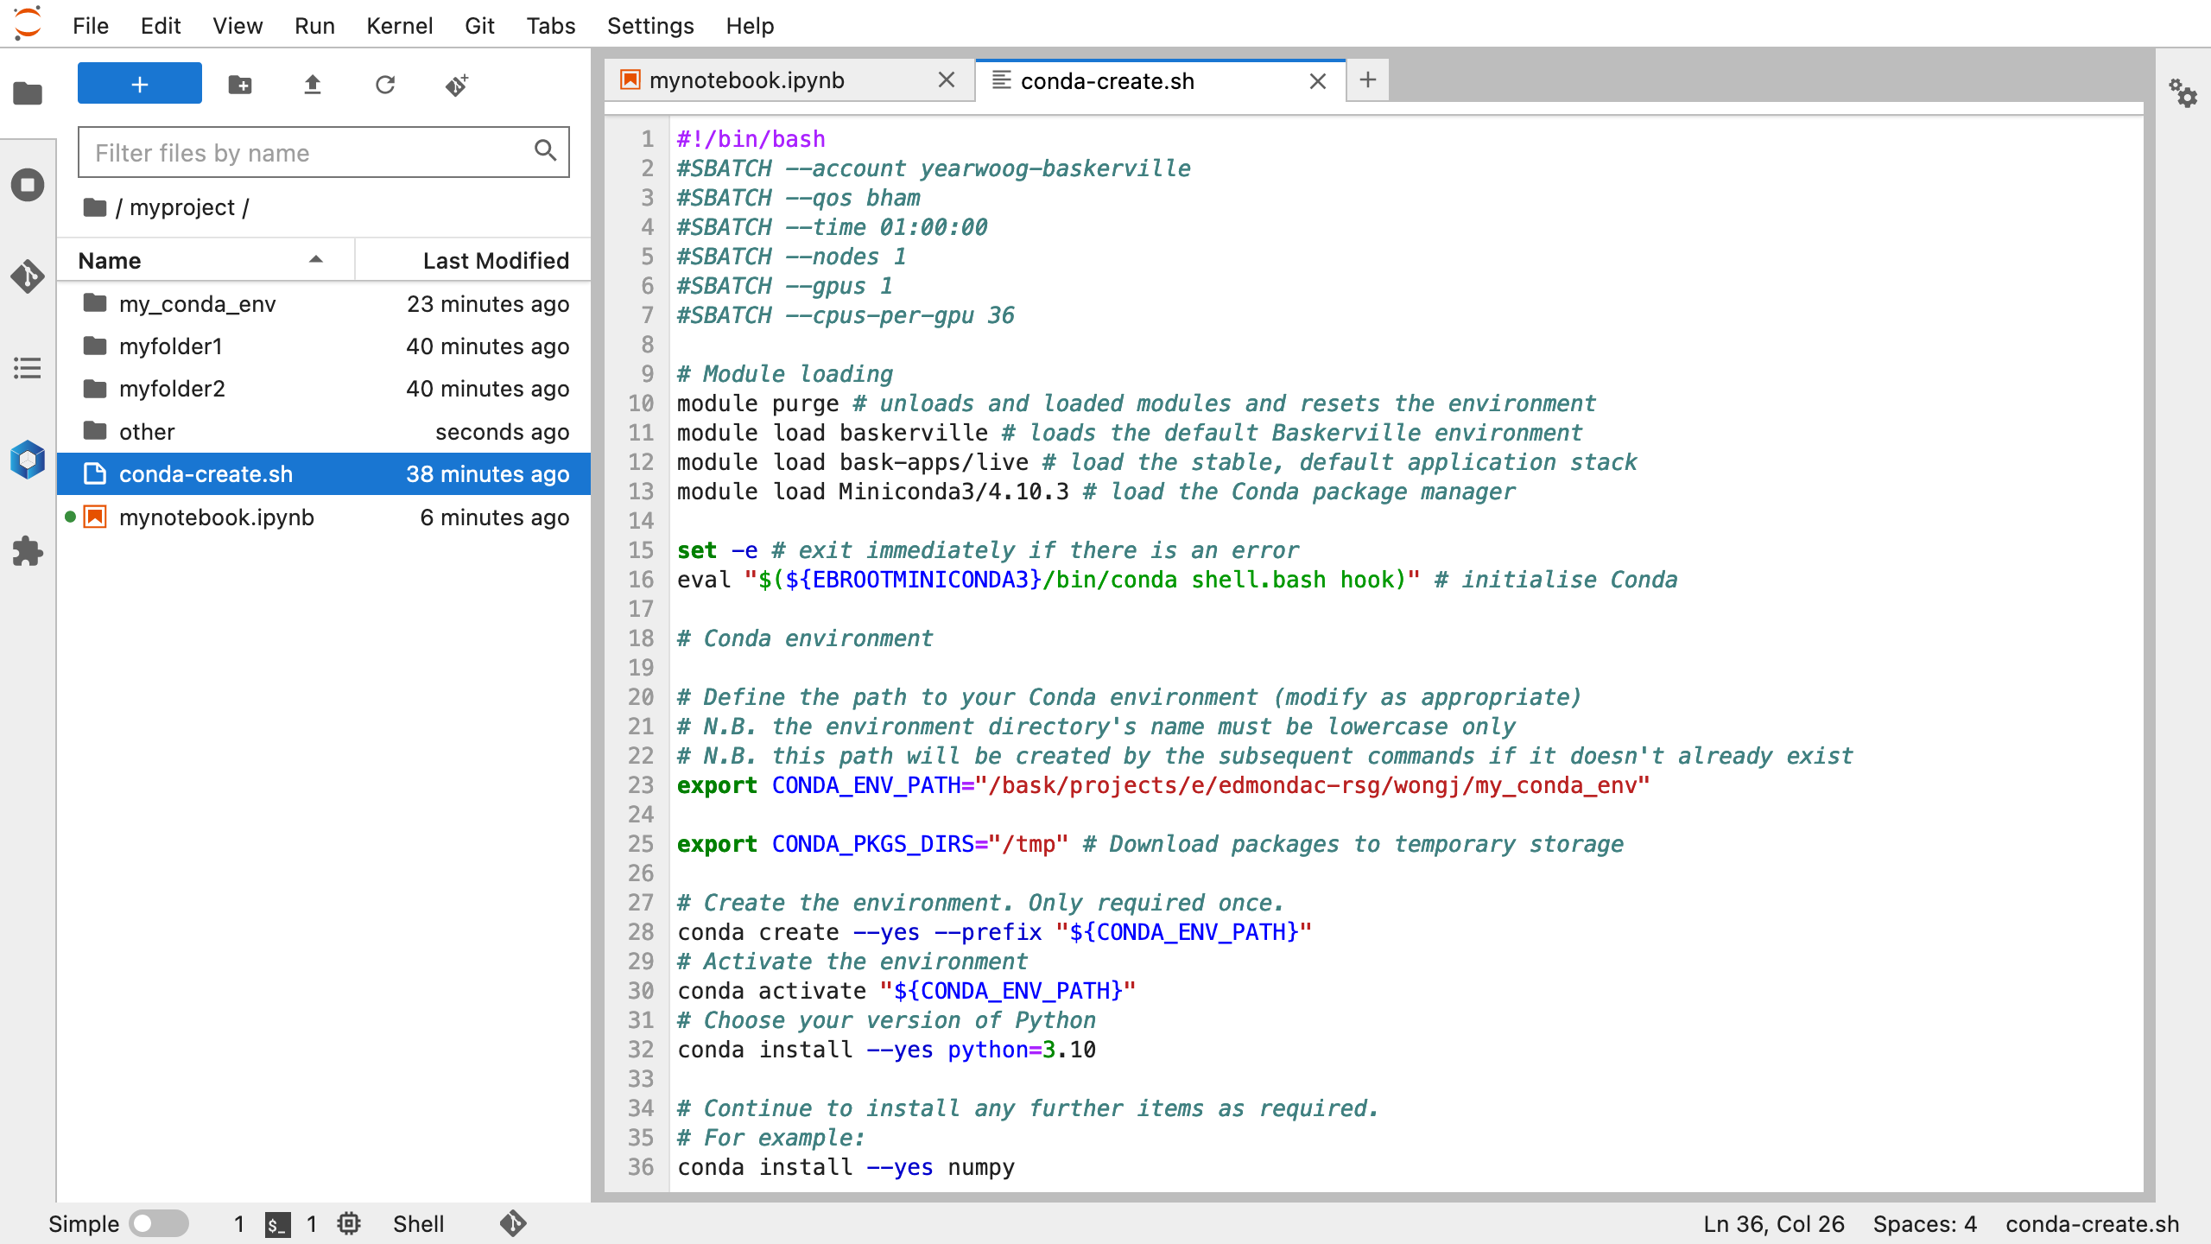
Notes:
export $CONDA_ENV_PATH – define location for the conda environment, emphasise that will need to be amended according to project folder and is lower case only
export $CONDA_PKGS_DIRS=“/tmp” – download packages to temporary storage
conda create –yes –prefix “${CONDA_ENV_PATH}” – create conda environment
conda activate “${CONDA_ENV_PATH}” – activate the environment
conda install –yes python=3.10 - install python 3.10
conda install –yes numpy – install numpy

Slide 41
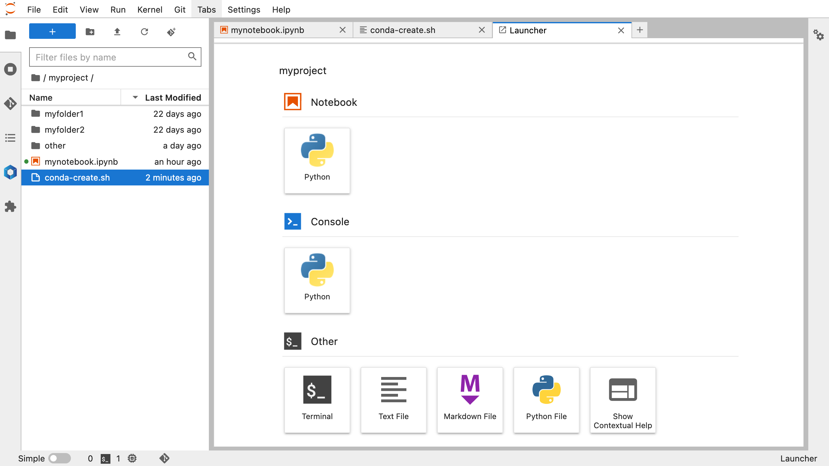
New Terminal
Notes:
click button to launch Terminal

Slide 42
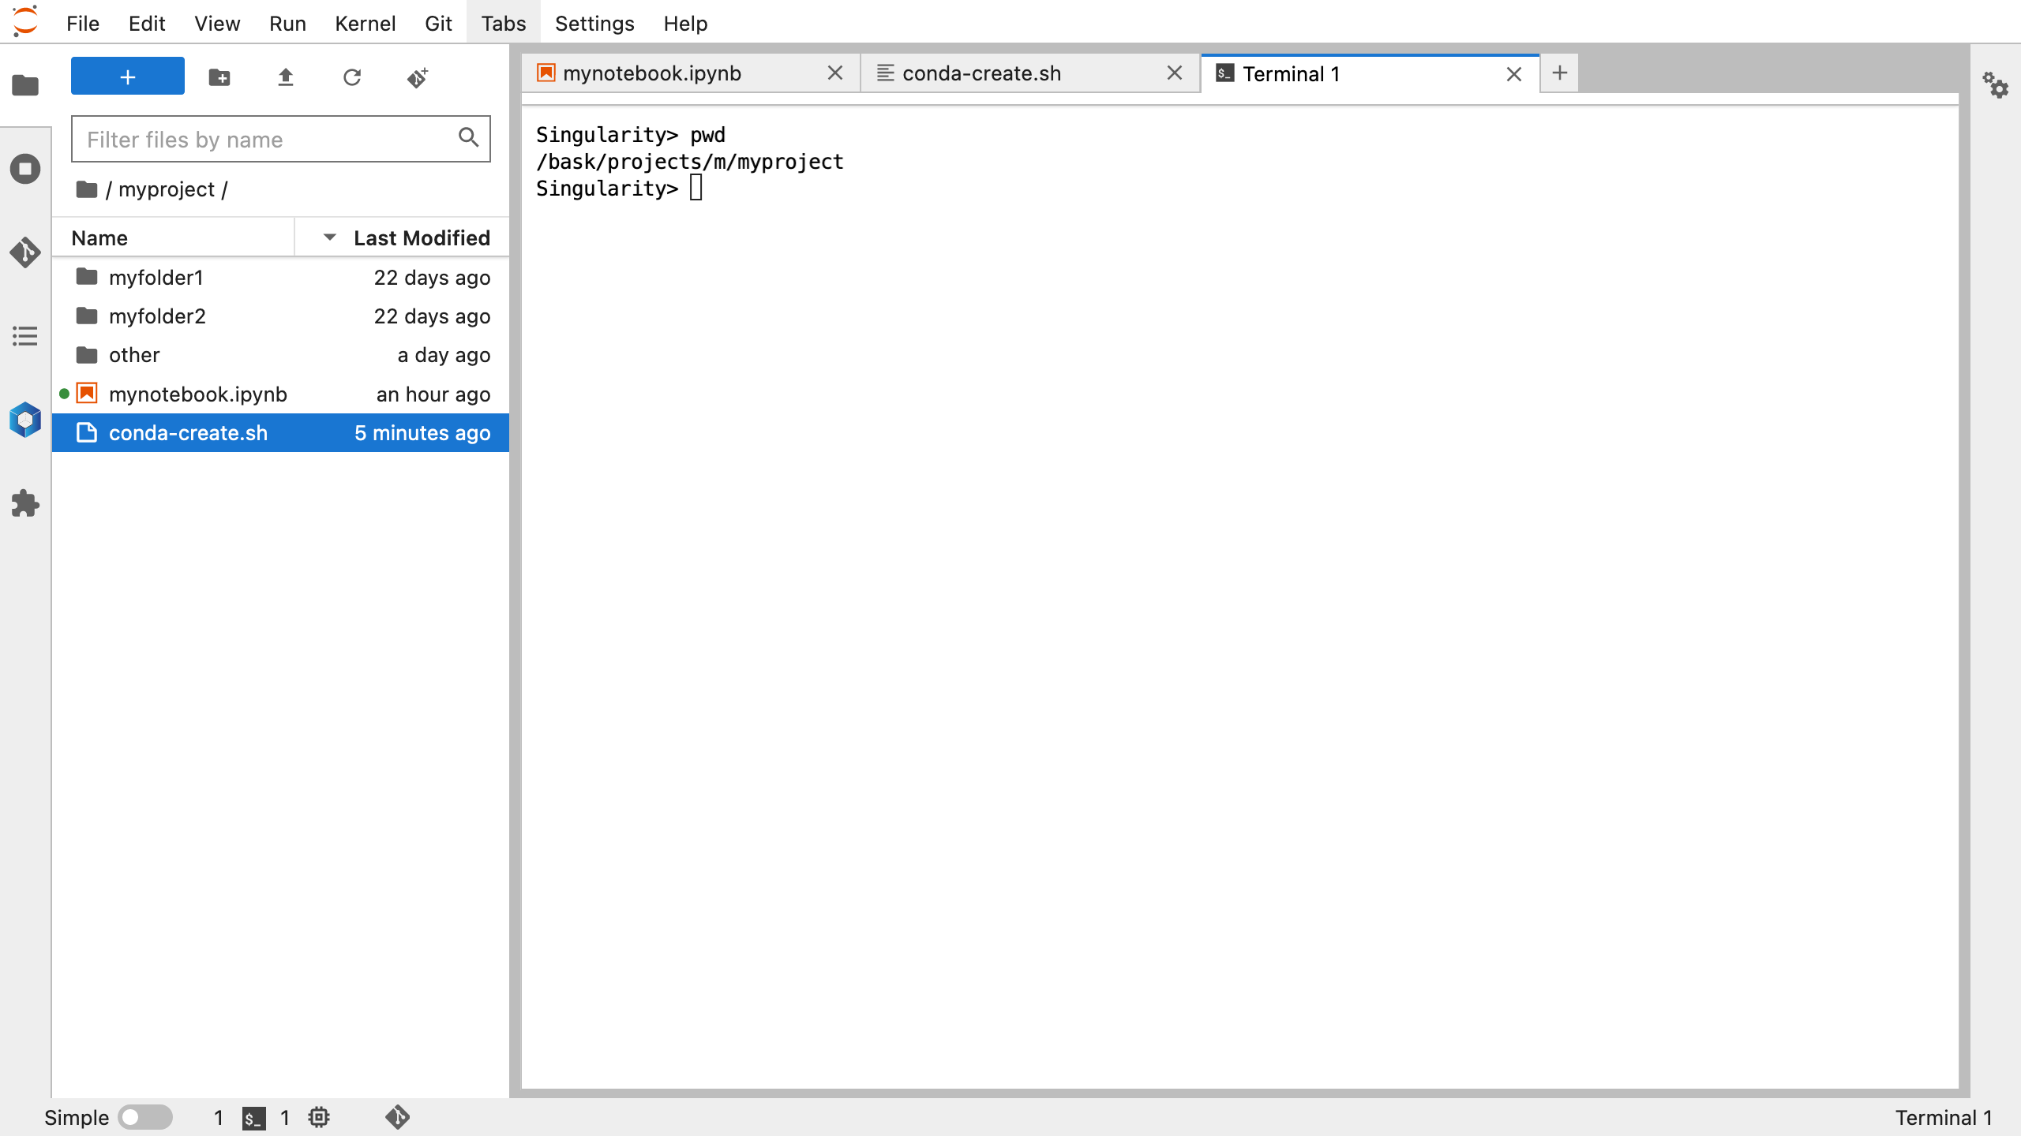
pwd – check current directory is the myproject folder
(if not, cd /bask/projects/m/myproject)
Notes:
pwd – check current directory is the myproject folder
(if not, cd /bask/projects/m/myproject)

Slide 43
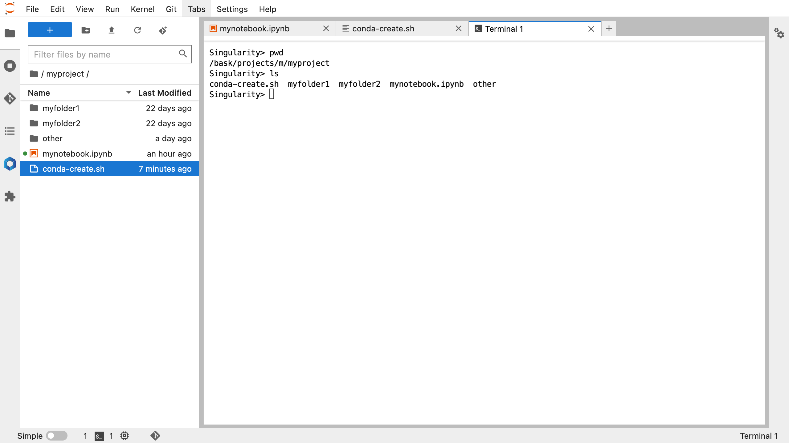
pwd – check current directory is the myproject folder
(if not, cd /bask/projects/m/myproject)
ls – list files and folders
Notes:
pwd – check current directory is the myproject folder
(if not, cd /bask/projects/m/myproject)
ls – list files and folders

Slide 44
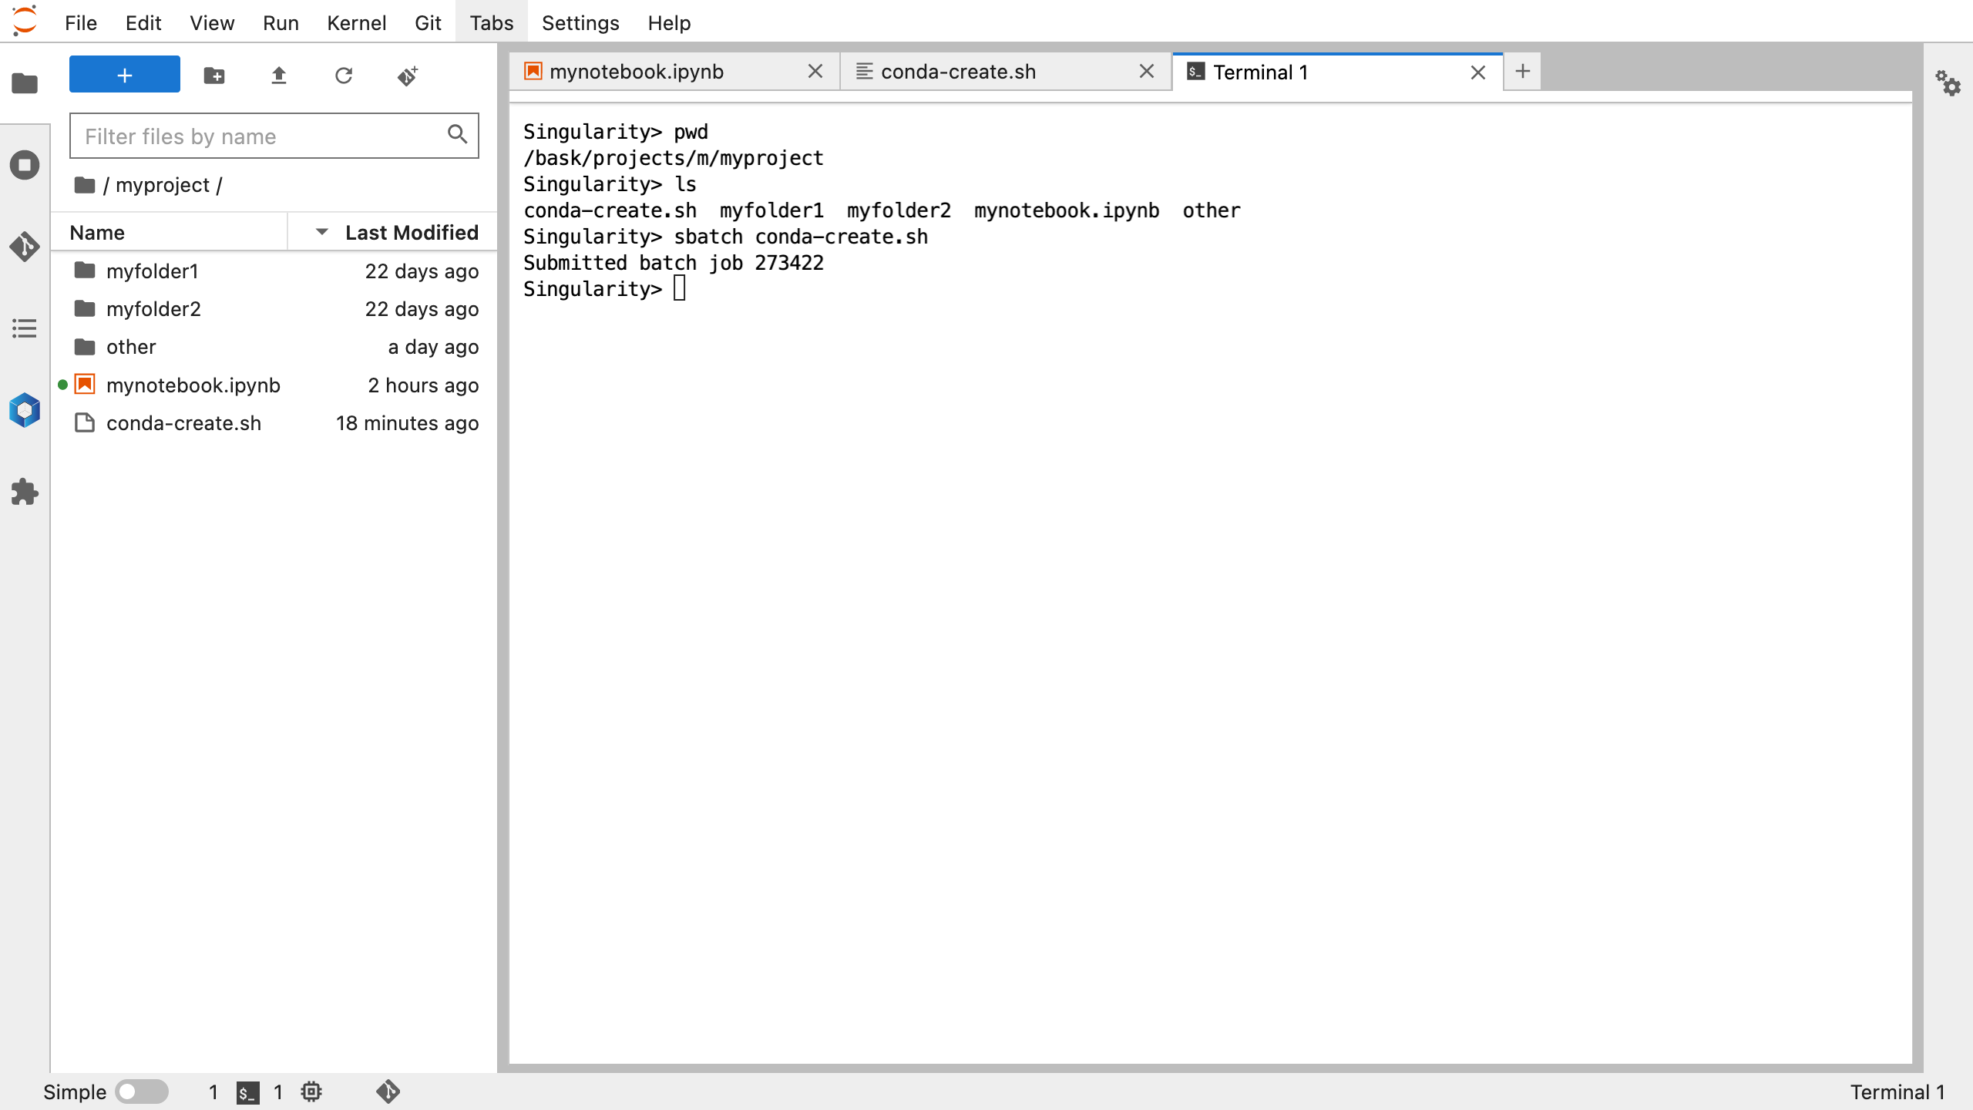
pwd – check current directory is the myproject folder
(if not, cd /bask/projects/m/myproject)
ls – list files and folders
sbatch conda-create.sh – submit batch job
Notes:
pwd – check current directory is the myproject folder
(if not, cd /bask/projects/m/myproject)
ls – list files and folders
sbatch conda-create.sh – submit batch job

Slide 45
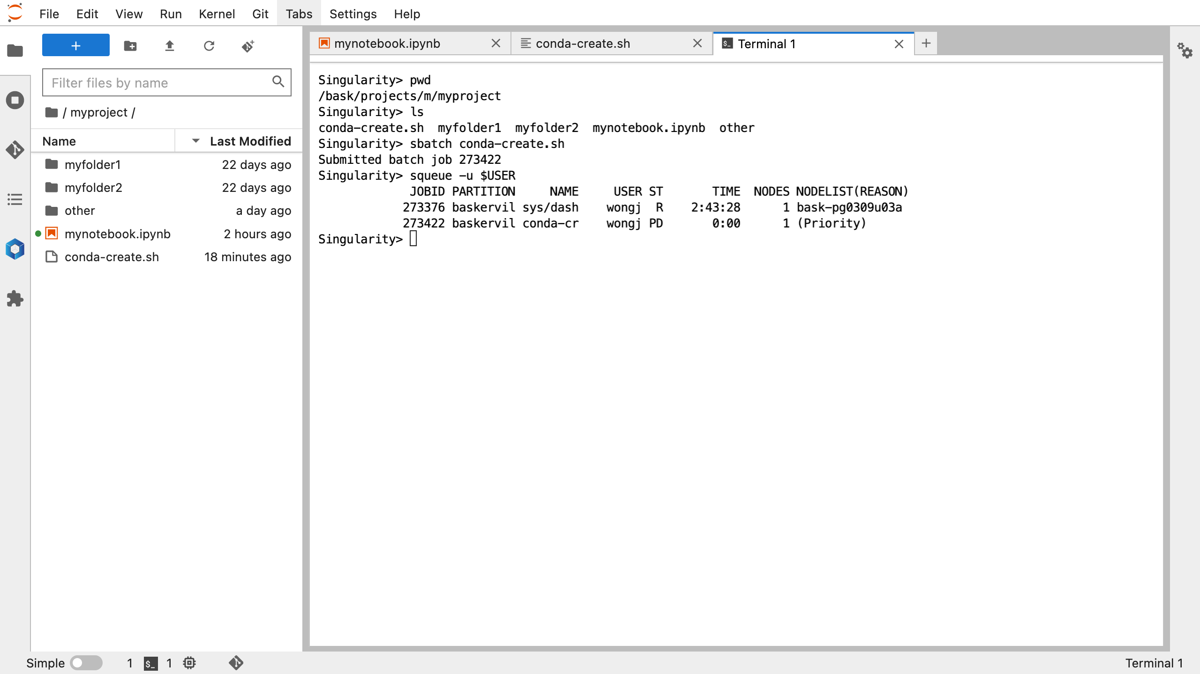
pwd – check current directory is the myproject folder
(if not, cd /bask/projects/m/myproject)
ls – list files and folders
sbatch conda-create.sh – submit batch job
squeue –u $USER – check your job status
Notes:
pwd – check current directory is the myproject folder
(if not, cd /bask/projects/m/myproject)
ls – list files and folders
sbatch conda-create.sh – submit batch job
squeue –u $USER – check your job status

Slide 46
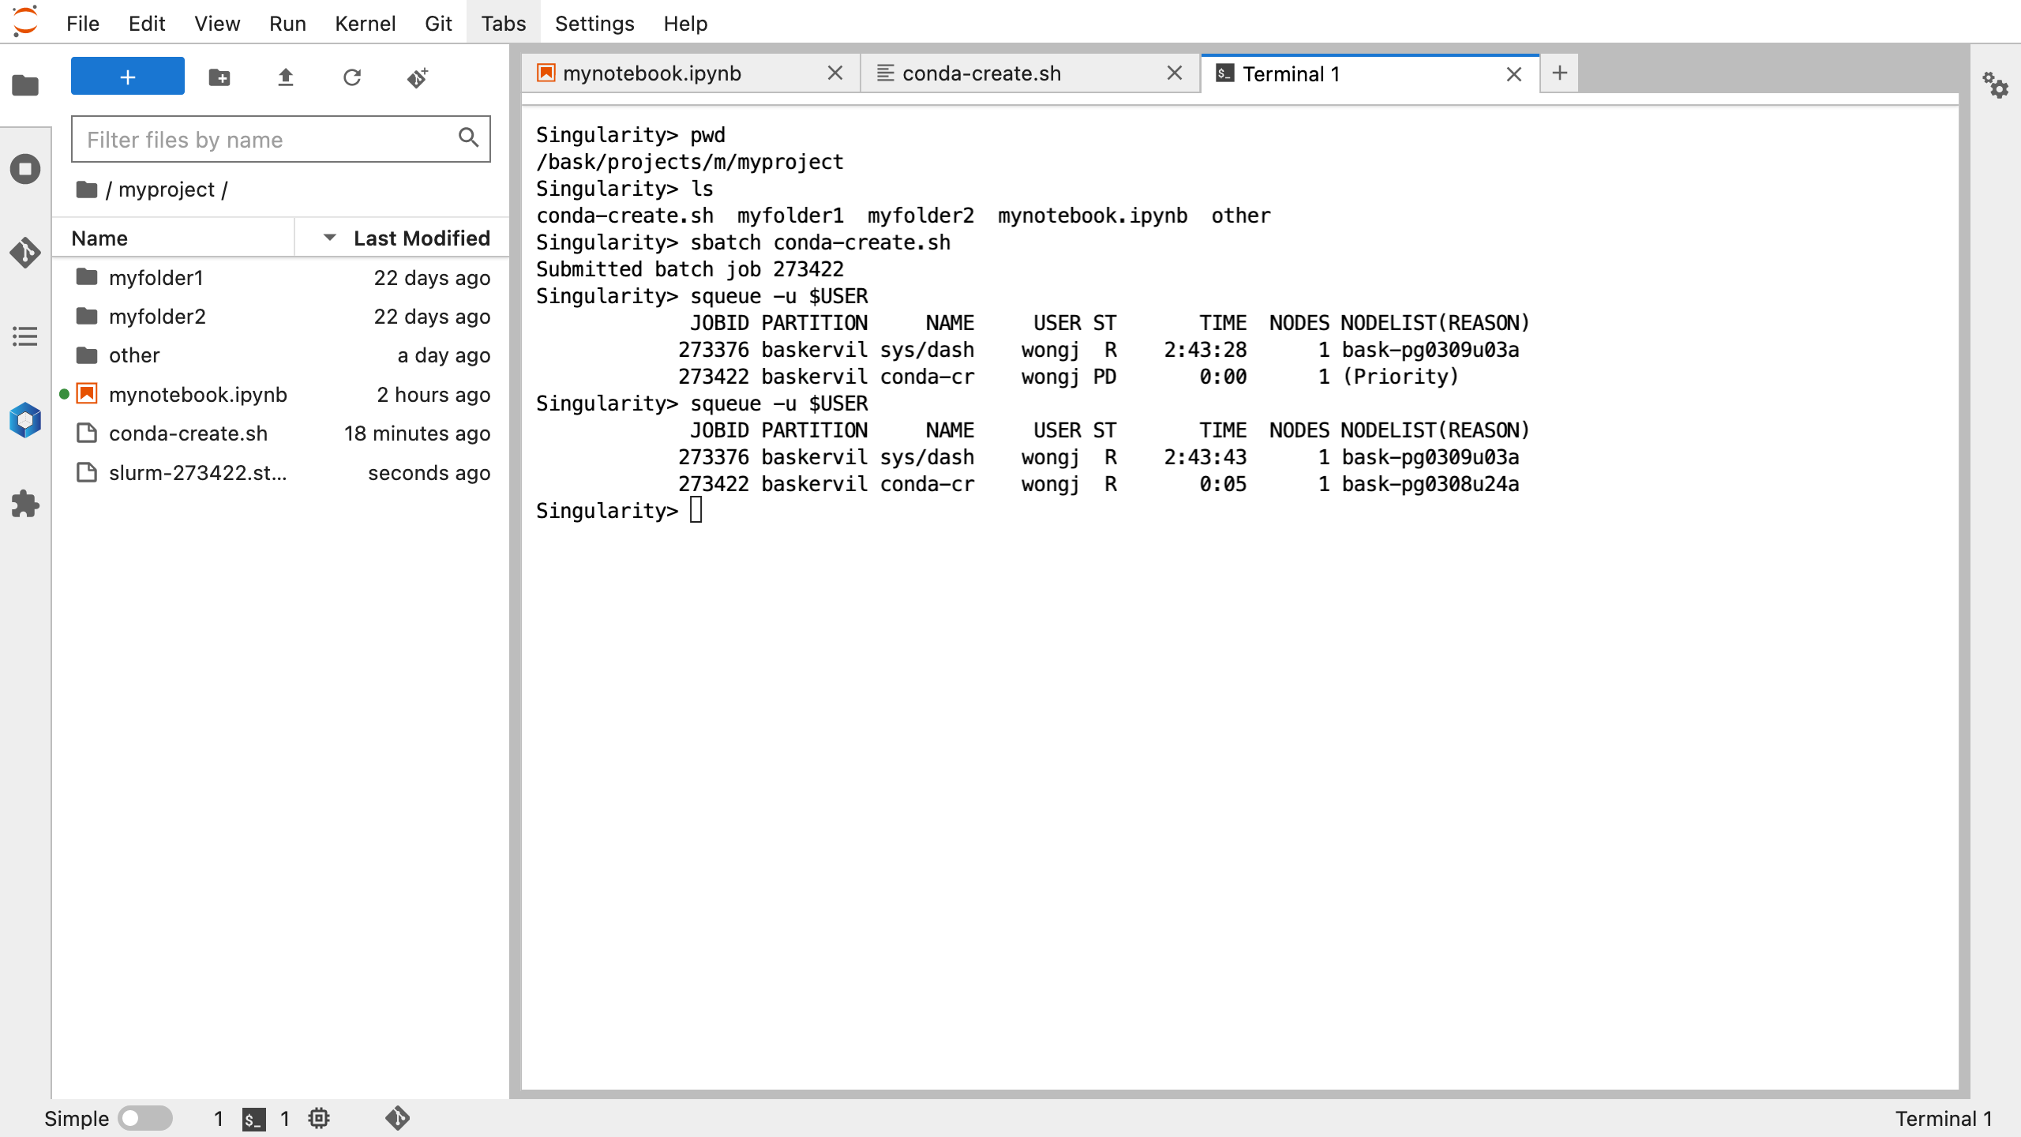
pwd – check current directory is the myproject folder
(if not, cd /bask/projects/m/myproject)
ls – list files and folders
sbatch conda-create.sh – submit batch job
squeue –u $USER – check your job status
pwd – check current directory is the myproject folder
(if not, cd /bask/projects/m/myproject)
ls – list files and folders
sbatch conda-create.sh – submit batch job
squeue –u $USER – check your job status
Notes:
pwd – check current directory is the myproject folder
(if not, cd /bask/projects/m/myproject)
ls – list files and folders
sbatch conda-create.sh – submit batch job
squeue –u $USER – check your job status

Slide 47
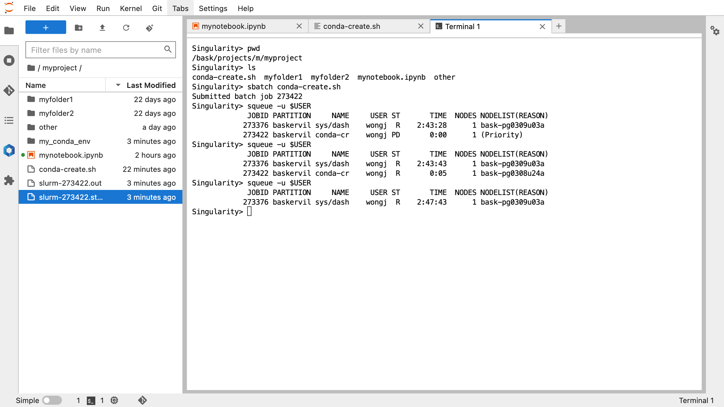
pwd – check current directory is the myproject folder
(if not, cd /bask/projects/m/myproject)
ls – list files and folders
sbatch conda-create.sh – submit batch job
squeue –u $USER – check your job status
my_conda_env – environment location
Notes:
pwd – check current directory is the myproject folder
(if not, cd /bask/projects/m/myproject)
ls – list files and folders
sbatch conda-create.sh – submit batch job
squeue –u $USER – check your job status
my_conda_env – environment location (emphasise name is what the user has defined in $CONDA_ENV_PATH)

Slide 48
pwd – check current directory is the myproject folder
(if not, cd /bask/projects/m/myproject)
ls – list files and folders
sbatch conda-create.sh – submit batch job
squeue –u $USER – check your job status
my_conda_env – environment location
slurm-xxxxxx.out – output file
slurm-xxxxxx.stats – stats file
Notes:
pwd – check current directory is the myproject folder
(if not, cd /bask/projects/m/myproject)
ls – list files and folders
sbatch conda-create.sh – submit batch job
squeue –u $USER – check your job status
my_conda_env – environment location (emphasise name is what the user has defined in $CONDA_ENV_PATH)
slurm-xxxxxx.out – output file
slurm-xxxxxx.stats – stats file

Slide 49
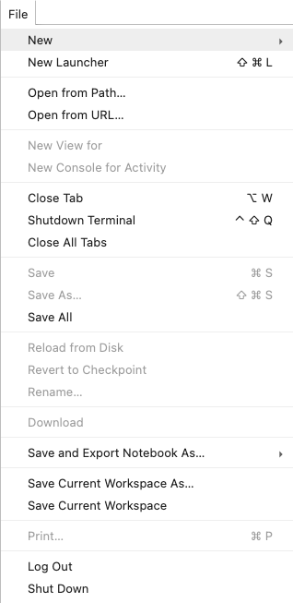
pwd – check current directory is the myproject folder
(if not, cd /bask/projects/m/myproject)
ls – list files and folders
sbatch conda-create.sh – submit batch job
squeue –u $USER – check your job status
my_conda_env – environment location
slurm-xxxxxx.out – output file
slurm-xxxxxx.stats – stats file
Restart session
Notes:
Shut down and Restart session (next Section for details) for the new environment kernel to become available.

Slide 50
3. JupyterLab
b) Conda Environments
(ii) Relaunch JupterLab and load new kernel

Slide 51

Relaunch JupyterLab and load new kernel
This time, tick to enable
Show Conda Environments
myproject
myqueue
Notes:
This time, tick to enable Show Conda Environments

Slide 52
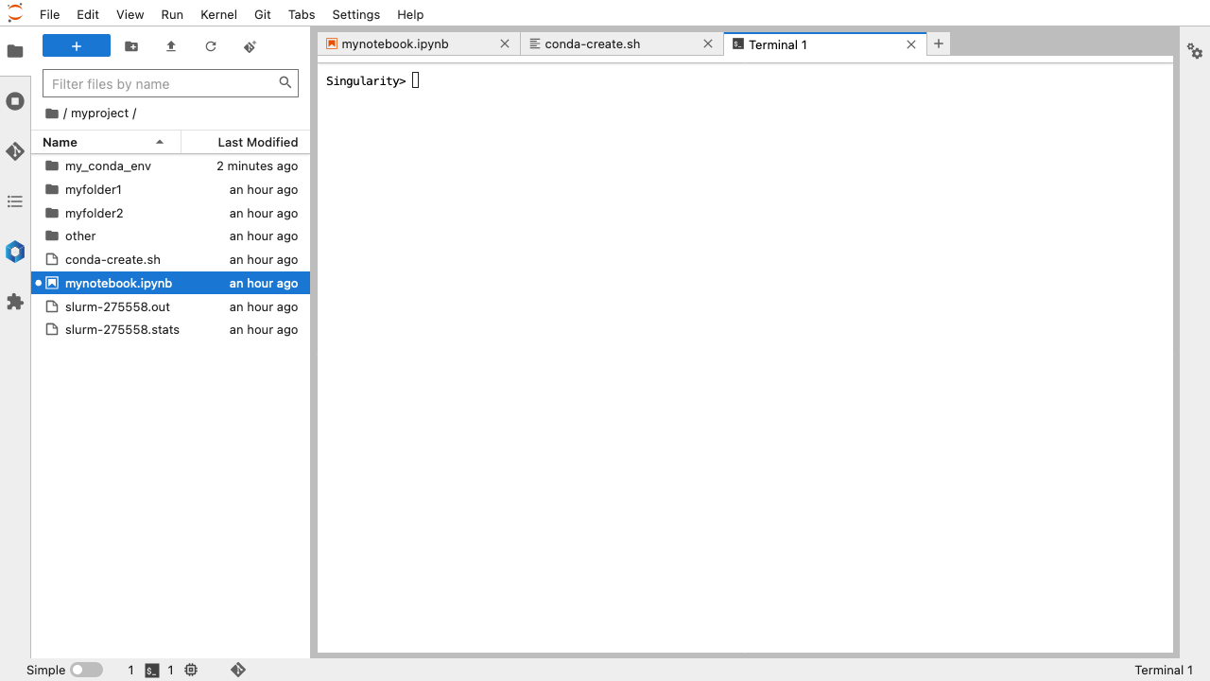
Notes:
Once connected, open a new launcher window by clicking the + symbol

Slide 53
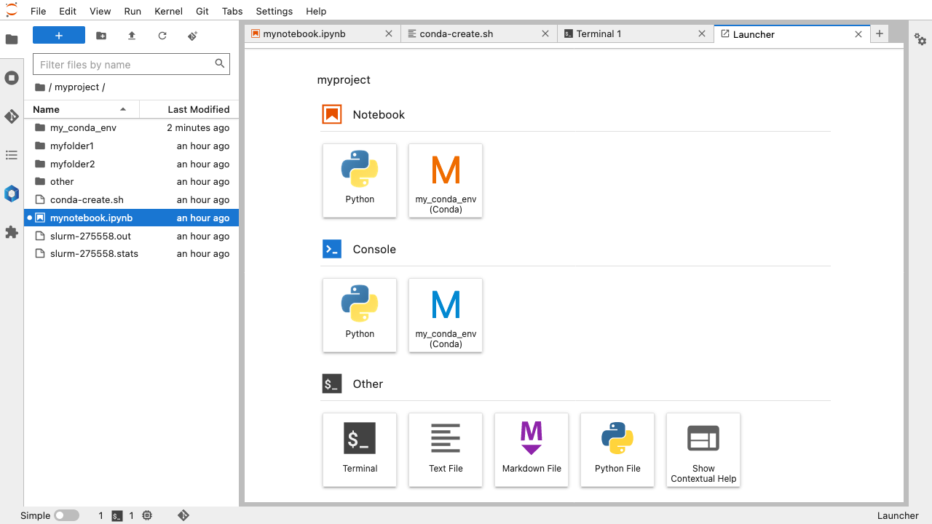
Notes:
Once connected, open a new launcher window by clicking the + symbol
The launcher displays a new Notebook option labelled with newly created conda environment

Slide 54
Notes:
Once connected, open a new launcher window by clicking the + symbol
The launcher displays a new Notebook option with a kernel labelled by newly created conda environment
You can also select the new kernel with an existing notebook by clicking on kernel name in the top right hand corner (currently called Python)

Slide 55
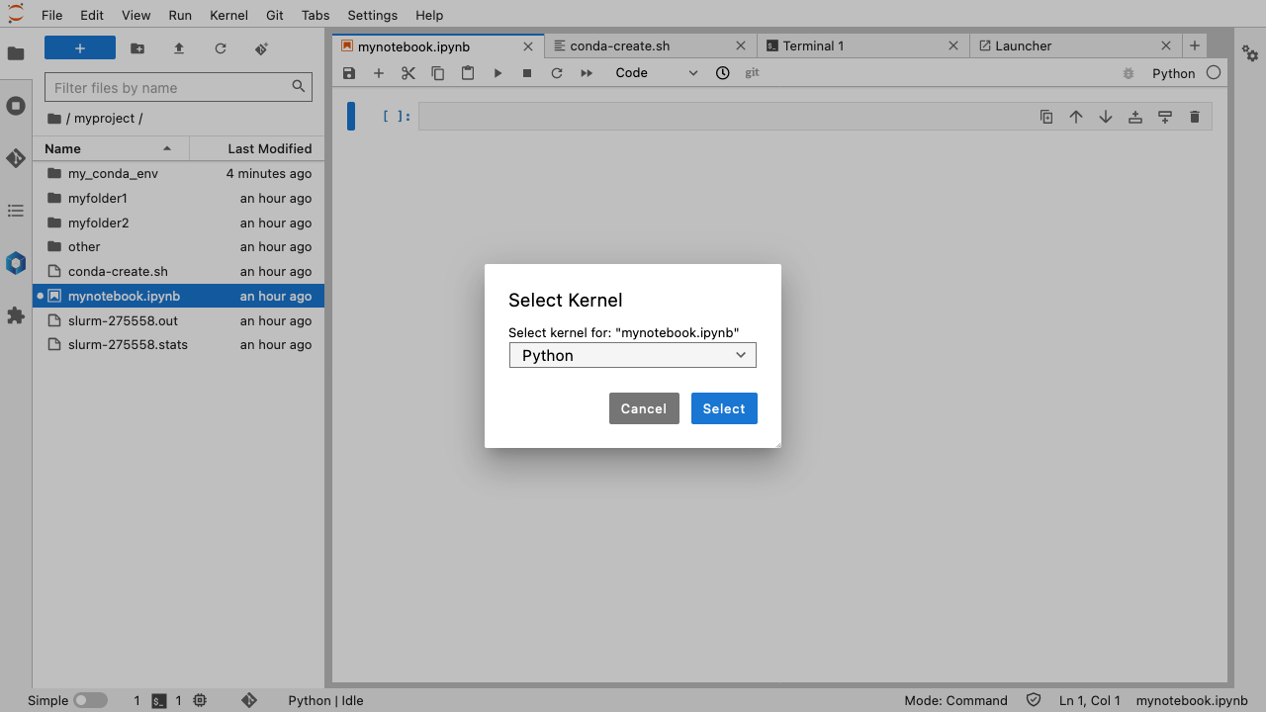
Notes:
Once connected, open a new launcher window by clicking the + symbol
The launcher displays a new Notebook option with a kernel labelled by newly created conda environment
You can also select the new kernel with an existing notebook by clicking on kernel name in the top right hand corner (currently called Python)
This opens a selection dialog box

Slide 56

Notes:
Once connected, open a new launcher window by clicking the + symbol
The launcher displays a new Notebook option with a kernel labelled by newly created conda environment
You can also select the new kernel with an existing notebook by clicking on kernel name in the top right hand corner (currently called Python)
This opens a selection dialog box – select new my_conda_env kernel

Slide 57
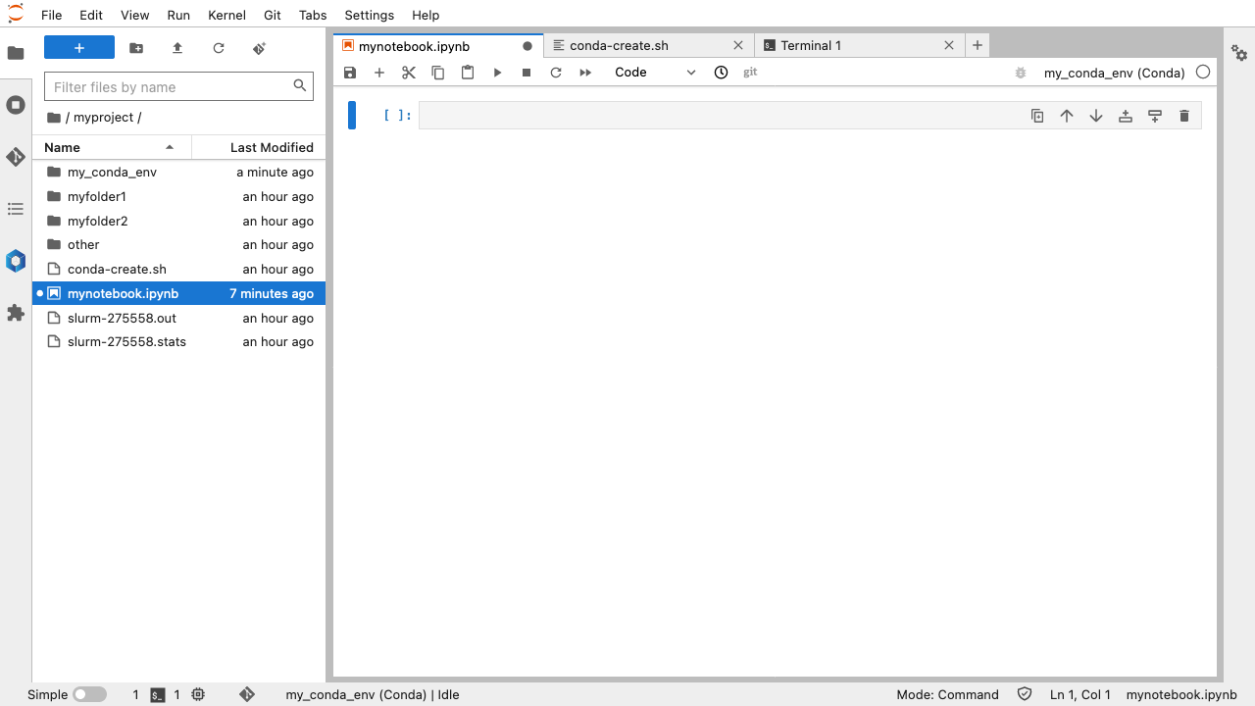

Slide 58
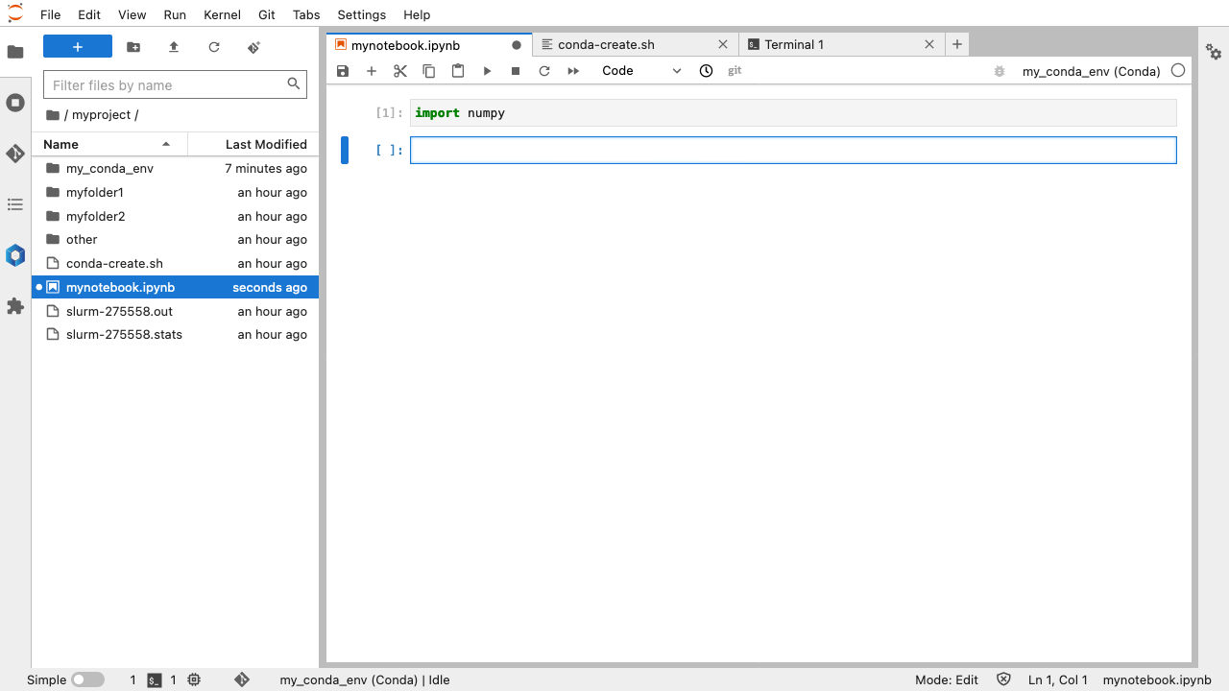
Notes:
import numpy

Slide 59
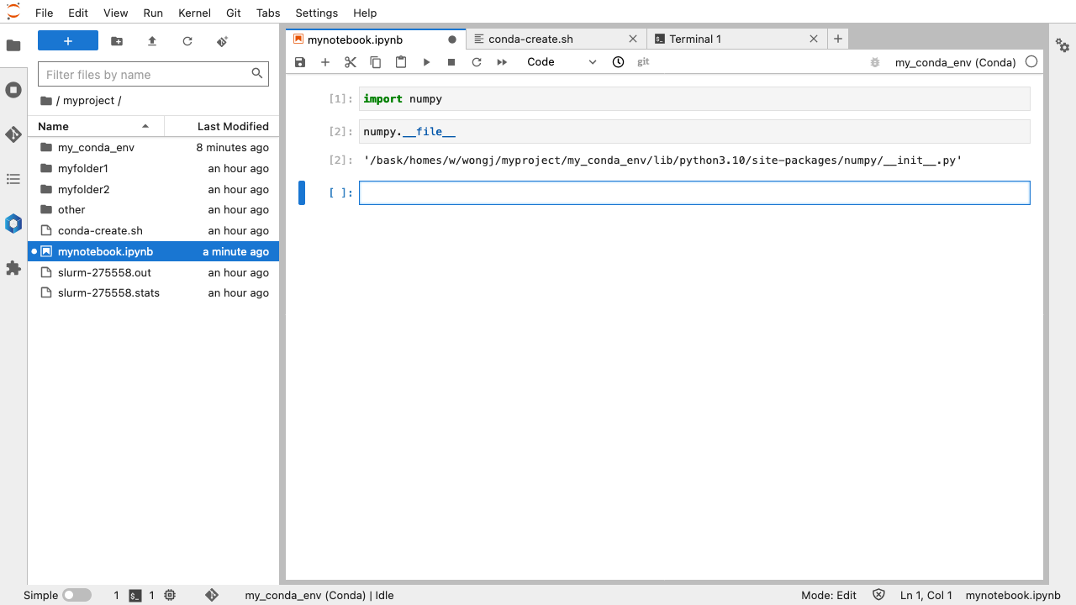
Notes:
import numpy
numpy.__file__ - see file location of numpy package installation

Slide 60
3. JupyterLab
b) Conda Environments
(iii) Modifying your environment

Slide 61
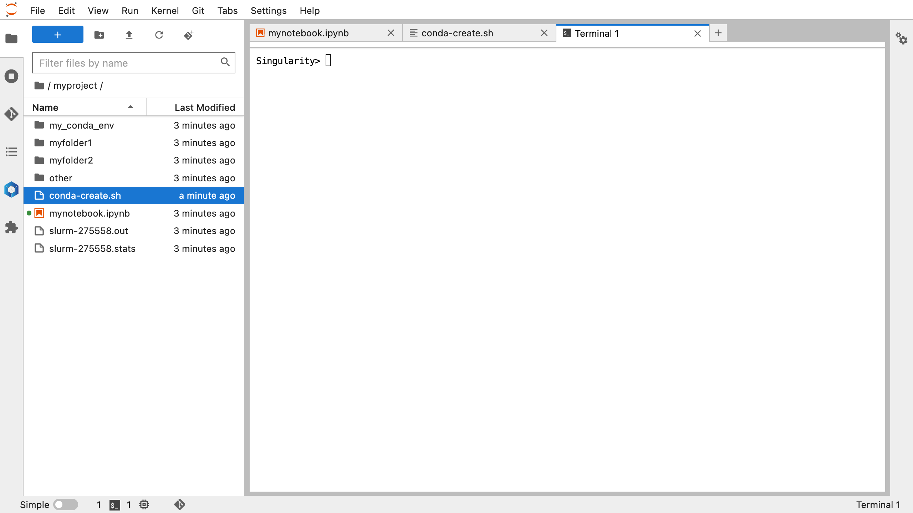
Notes:
Open a terminal window

Slide 62
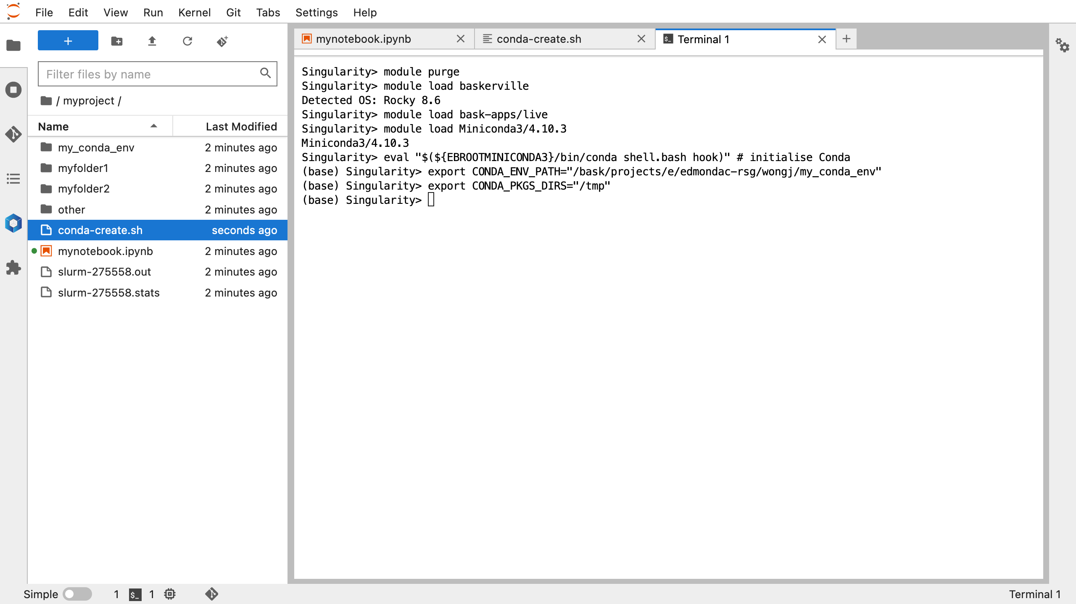
Notes:
Open a terminal window
Execute shell commands found in the header conda-create.sh
module purge – unloads loaded modules and resets the environment
module load baskerville – loads the defaul Baskerville environment
module load bask-apps/live – load the stable, default application stack
module load Miniconda – load the conda package manager
eval ”$({EBOOTMINICONDA3}/bin/conda shell.bash hook)” – initialise conda
export $CONDA_ENV_PATH – define location for the conda environment, emphasise that will need to be amended according to project folder and is lower case only
export $CONDA_PKGS_DIRS=“/tmp” – download packages to temporary storage

Slide 63
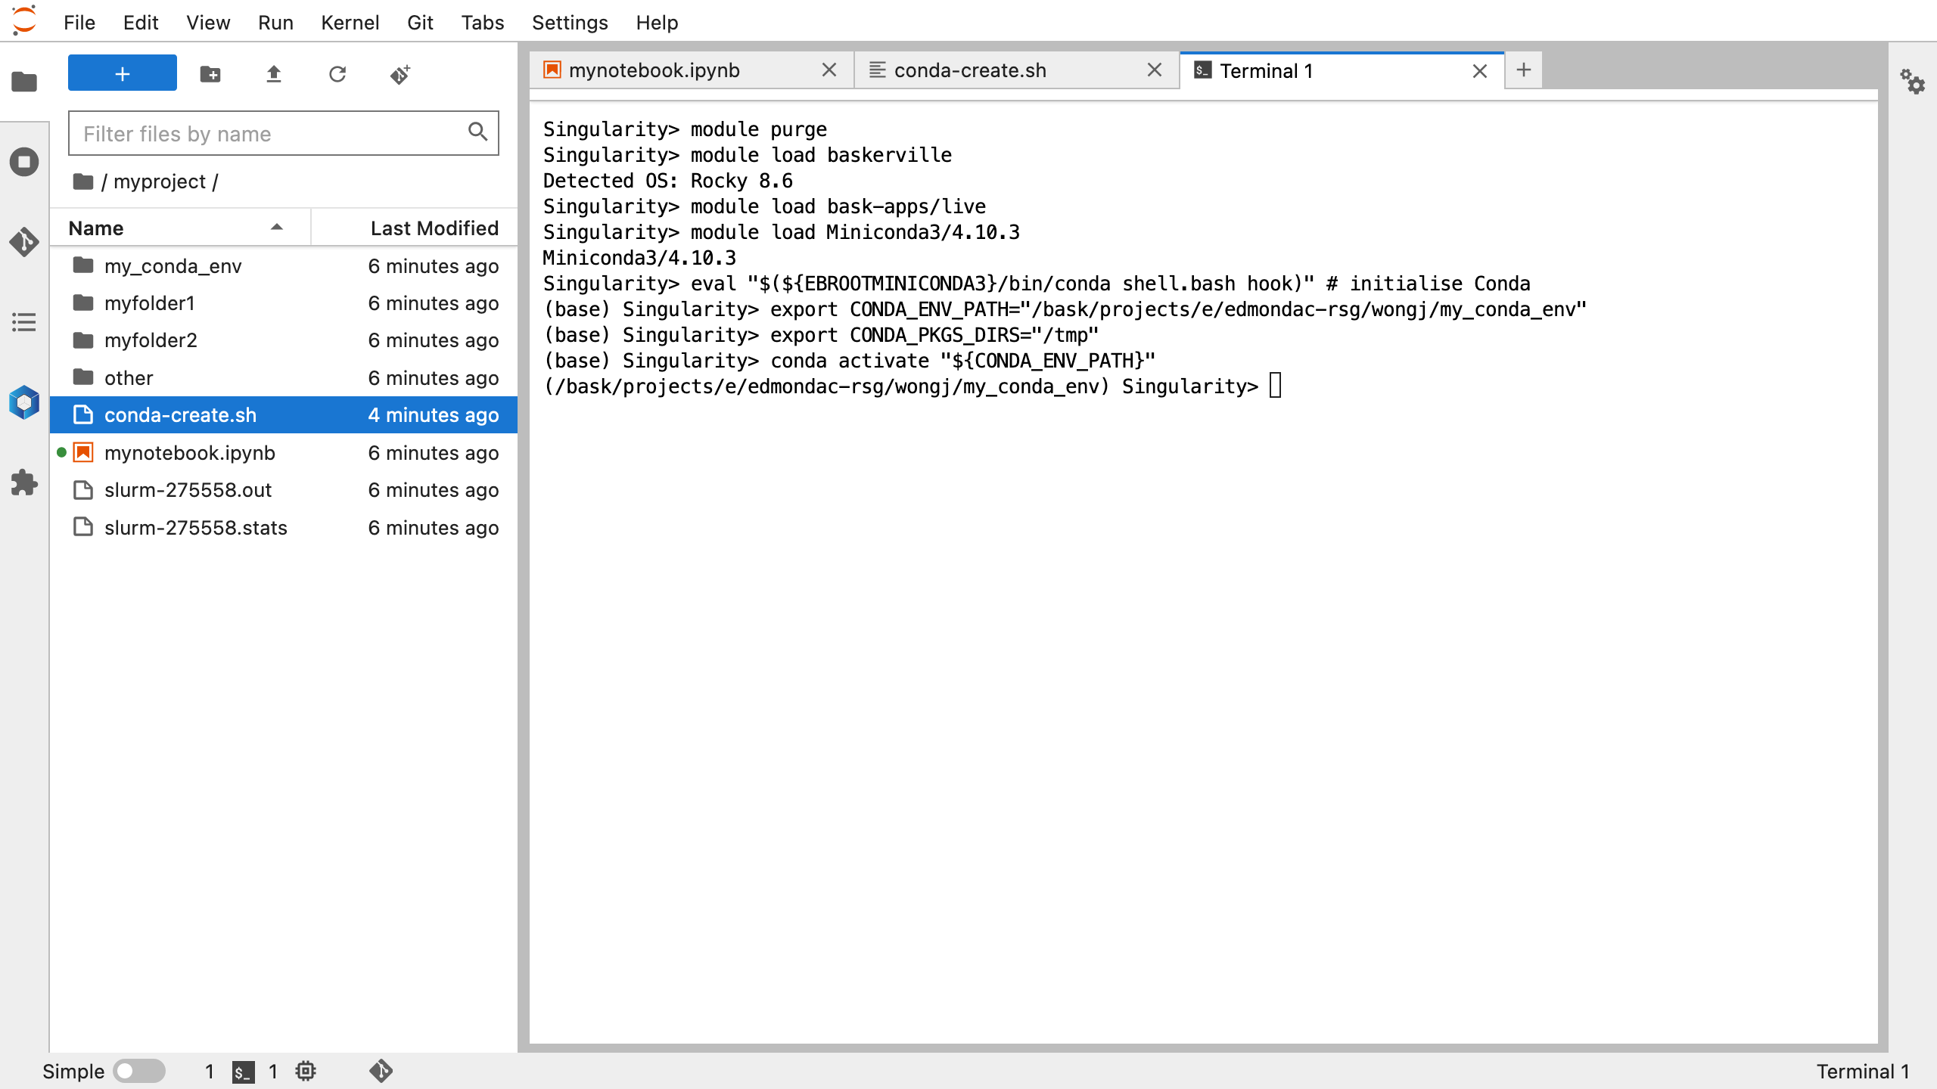
Notes:
Open a terminal window
Execute shell commands found in the header conda-create.sh
module purge – unloads loaded modules and resets the environment
module load baskerville – loads the defaul Baskerville environment
module load bask-apps/live – load the stable, default application stack
module load Miniconda – load the conda package manager
eval ”$({EBOOTMINICONDA3}/bin/conda shell.bash hook)” – initialise conda
export $CONDA_ENV_PATH – define location for the conda environment, emphasise that will need to be amended according to project folder and is lower case only
export $CONDA_PKGS_DIRS=“/tmp” – download packages to temporary storage
conda activate “${CONDA_ENV_PATH}” – activate the environment

Slide 64
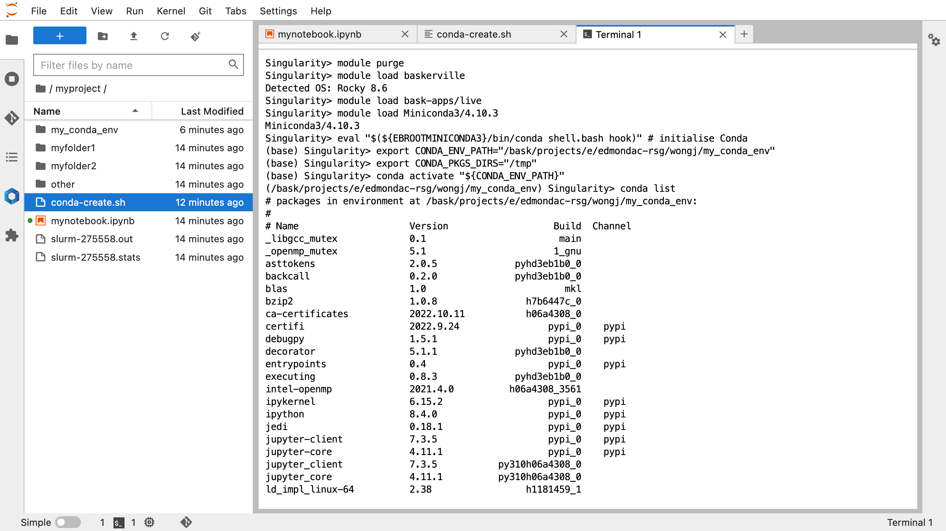
Notes:
Open a terminal window
Execute shell commands found in the header conda-create.sh
module purge – unloads loaded modules and resets the environment
module load baskerville – loads the defaul Baskerville environment
module load bask-apps/live – load the stable, default application stack
module load Miniconda – load the conda package manager
eval ”$({EBOOTMINICONDA3}/bin/conda shell.bash hook)” – initialise conda
export $CONDA_ENV_PATH – define location for the conda environment, emphasise that will need to be amended according to project folder and is lower case only
export $CONDA_PKGS_DIRS=“/tmp” – download packages to temporary storage
conda activate “${CONDA_ENV_PATH}” – activate the environment
conda list – show list of packages installed in active environment

Slide 65
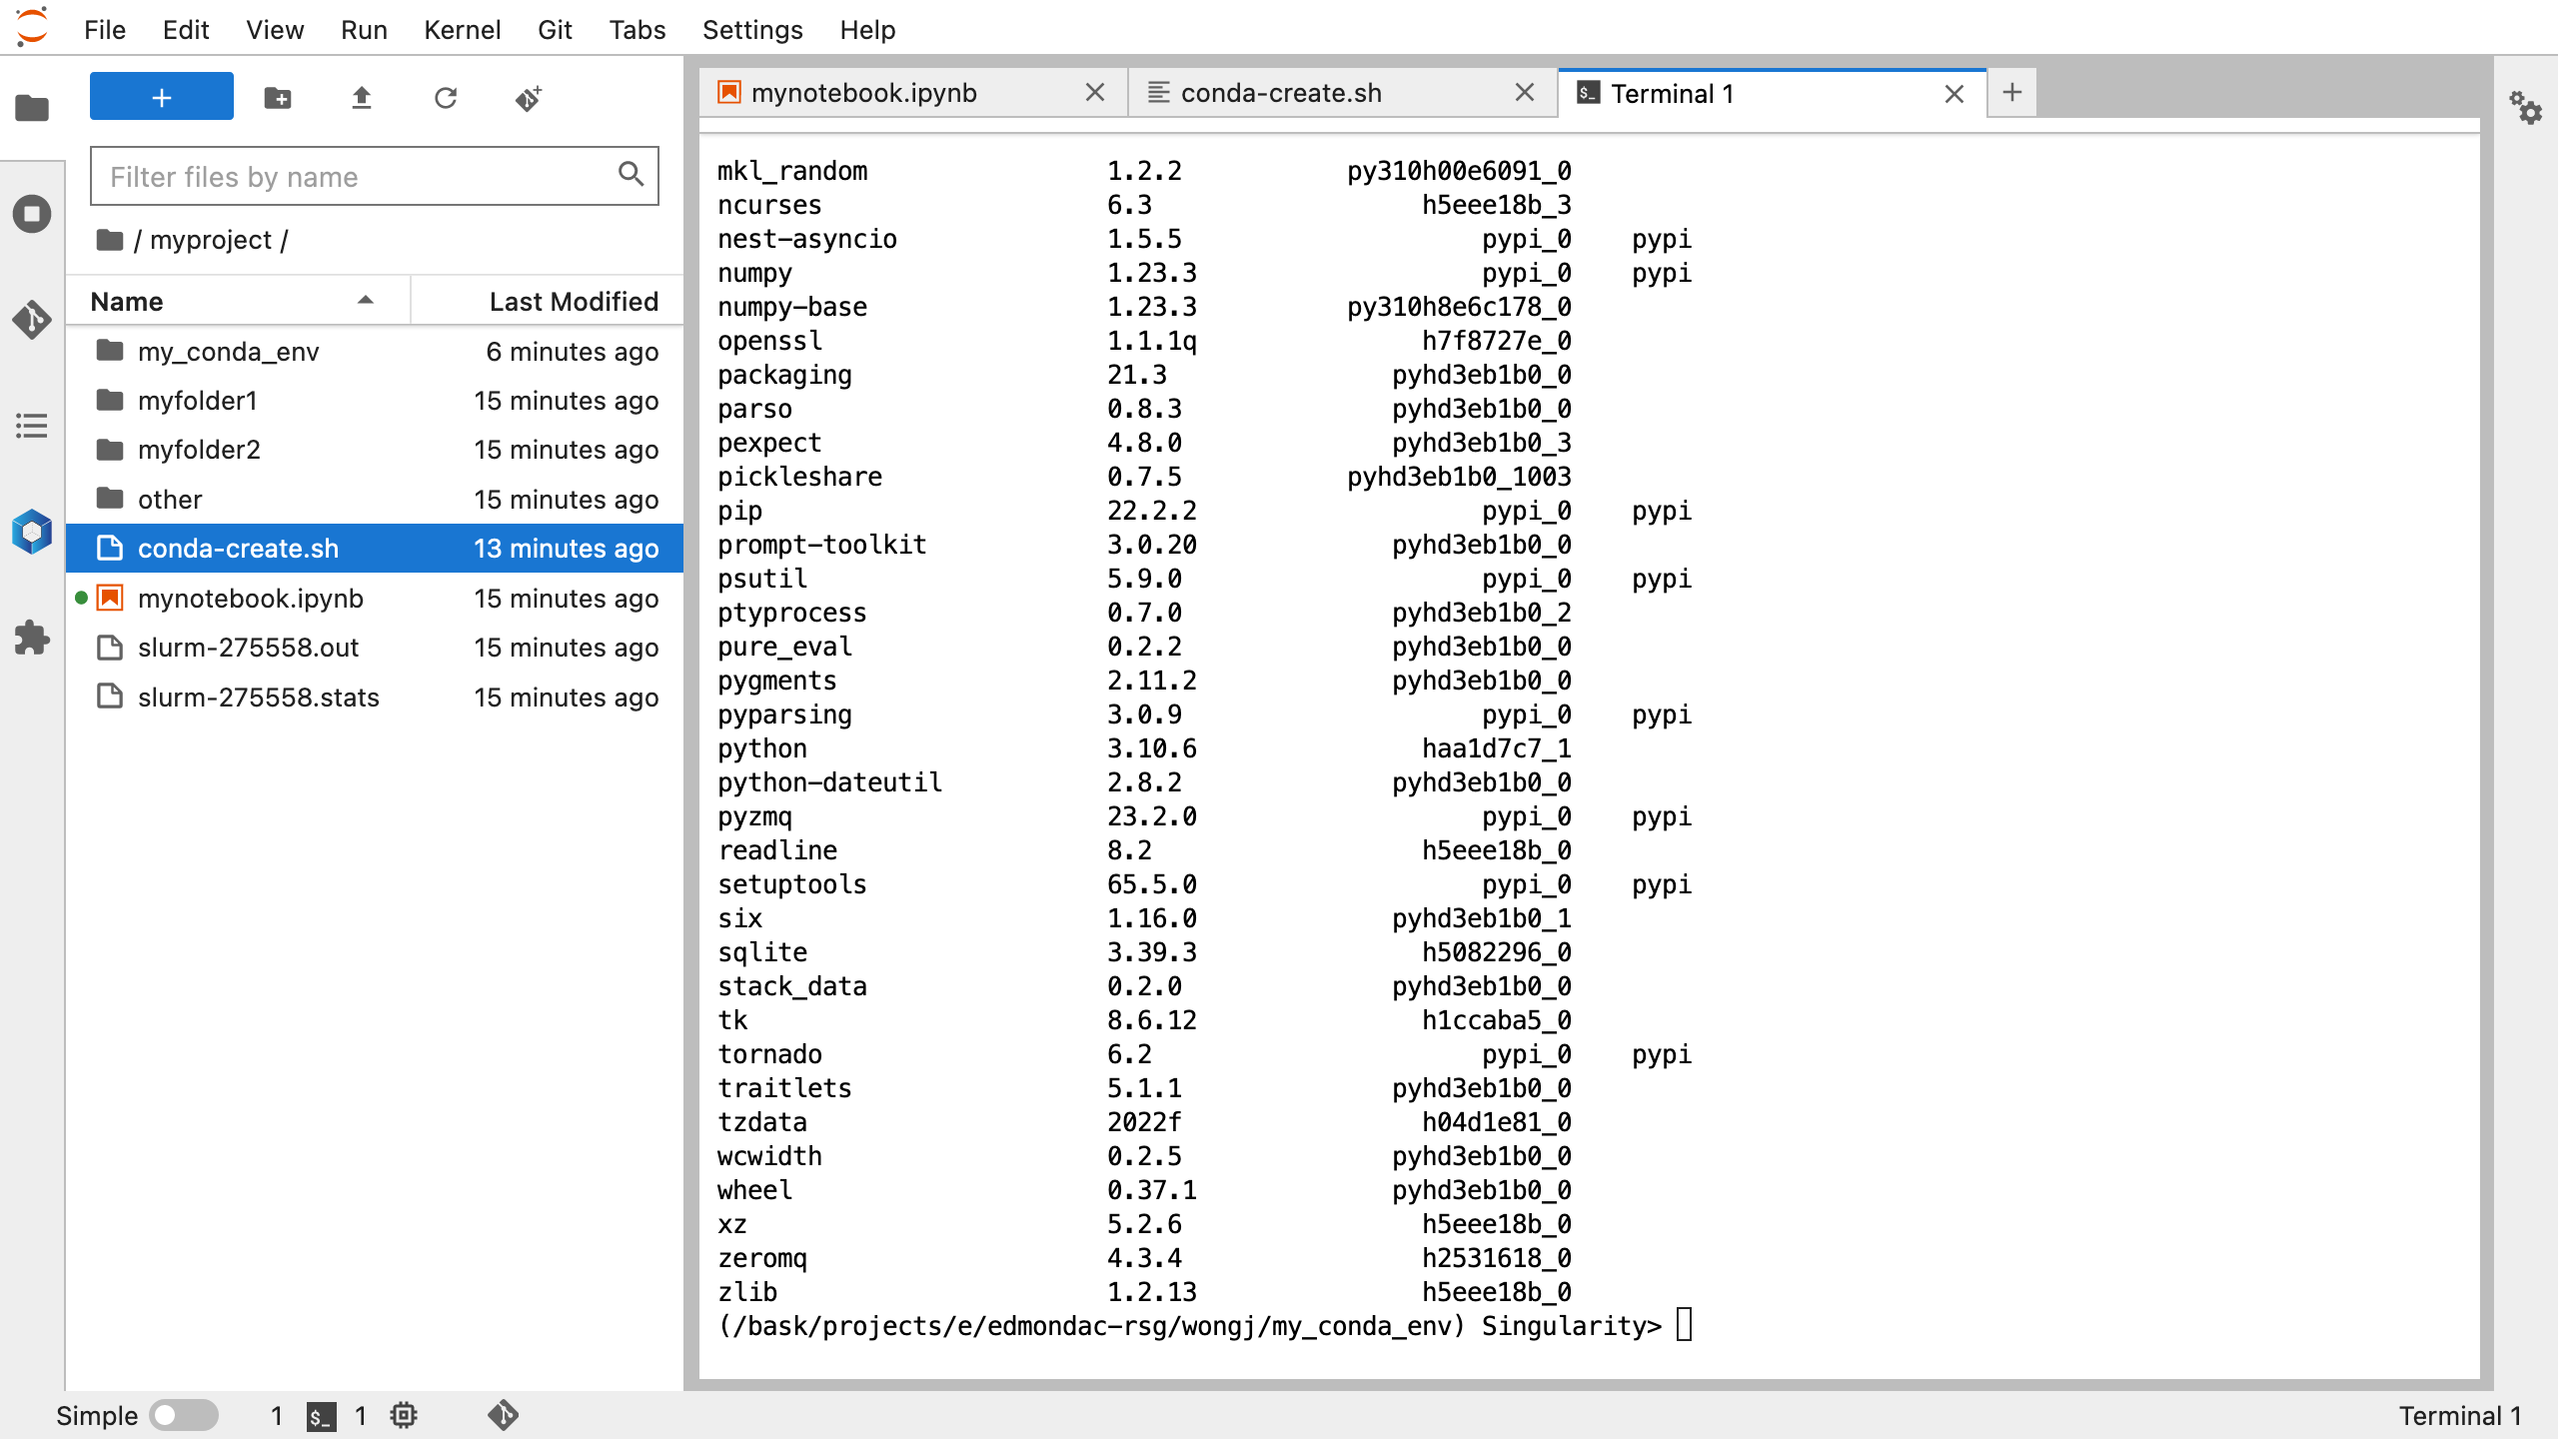
Notes:
Open a terminal window
Execute shell commands found in the header conda-create.sh
module purge – unloads loaded modules and resets the environment
module load baskerville – loads the defaul Baskerville environment
module load bask-apps/live – load the stable, default application stack
module load Miniconda – load the conda package manager
eval ”$({EBOOTMINICONDA3}/bin/conda shell.bash hook)” – initialise conda
export $CONDA_ENV_PATH – define location for the conda environment, emphasise that will need to be amended according to project folder and is lower case only
export $CONDA_PKGS_DIRS=“/tmp” – download packages to temporary storage
conda activate “${CONDA_ENV_PATH}” – activate the environment
conda list – show list of packages installed in active environment

Slide 66

Notes:
Open a terminal window
Execute shell commands found in the header conda-create.sh
module purge – unloads loaded modules and resets the environment
module load baskerville – loads the defaul Baskerville environment
module load bask-apps/live – load the stable, default application stack
module load Miniconda – load the conda package manager
eval ”$({EBOOTMINICONDA3}/bin/conda shell.bash hook)” – initialise conda
export $CONDA_ENV_PATH – define location for the conda environment, emphasise that will need to be amended according to project folder and is lower case only
export $CONDA_PKGS_DIRS=“/tmp” – download packages to temporary storage
conda activate “${CONDA_ENV_PATH}” – activate the environment
conda list – show list of packages installed in active environment
conda install pandas --yes – install pandas package

Slide 67
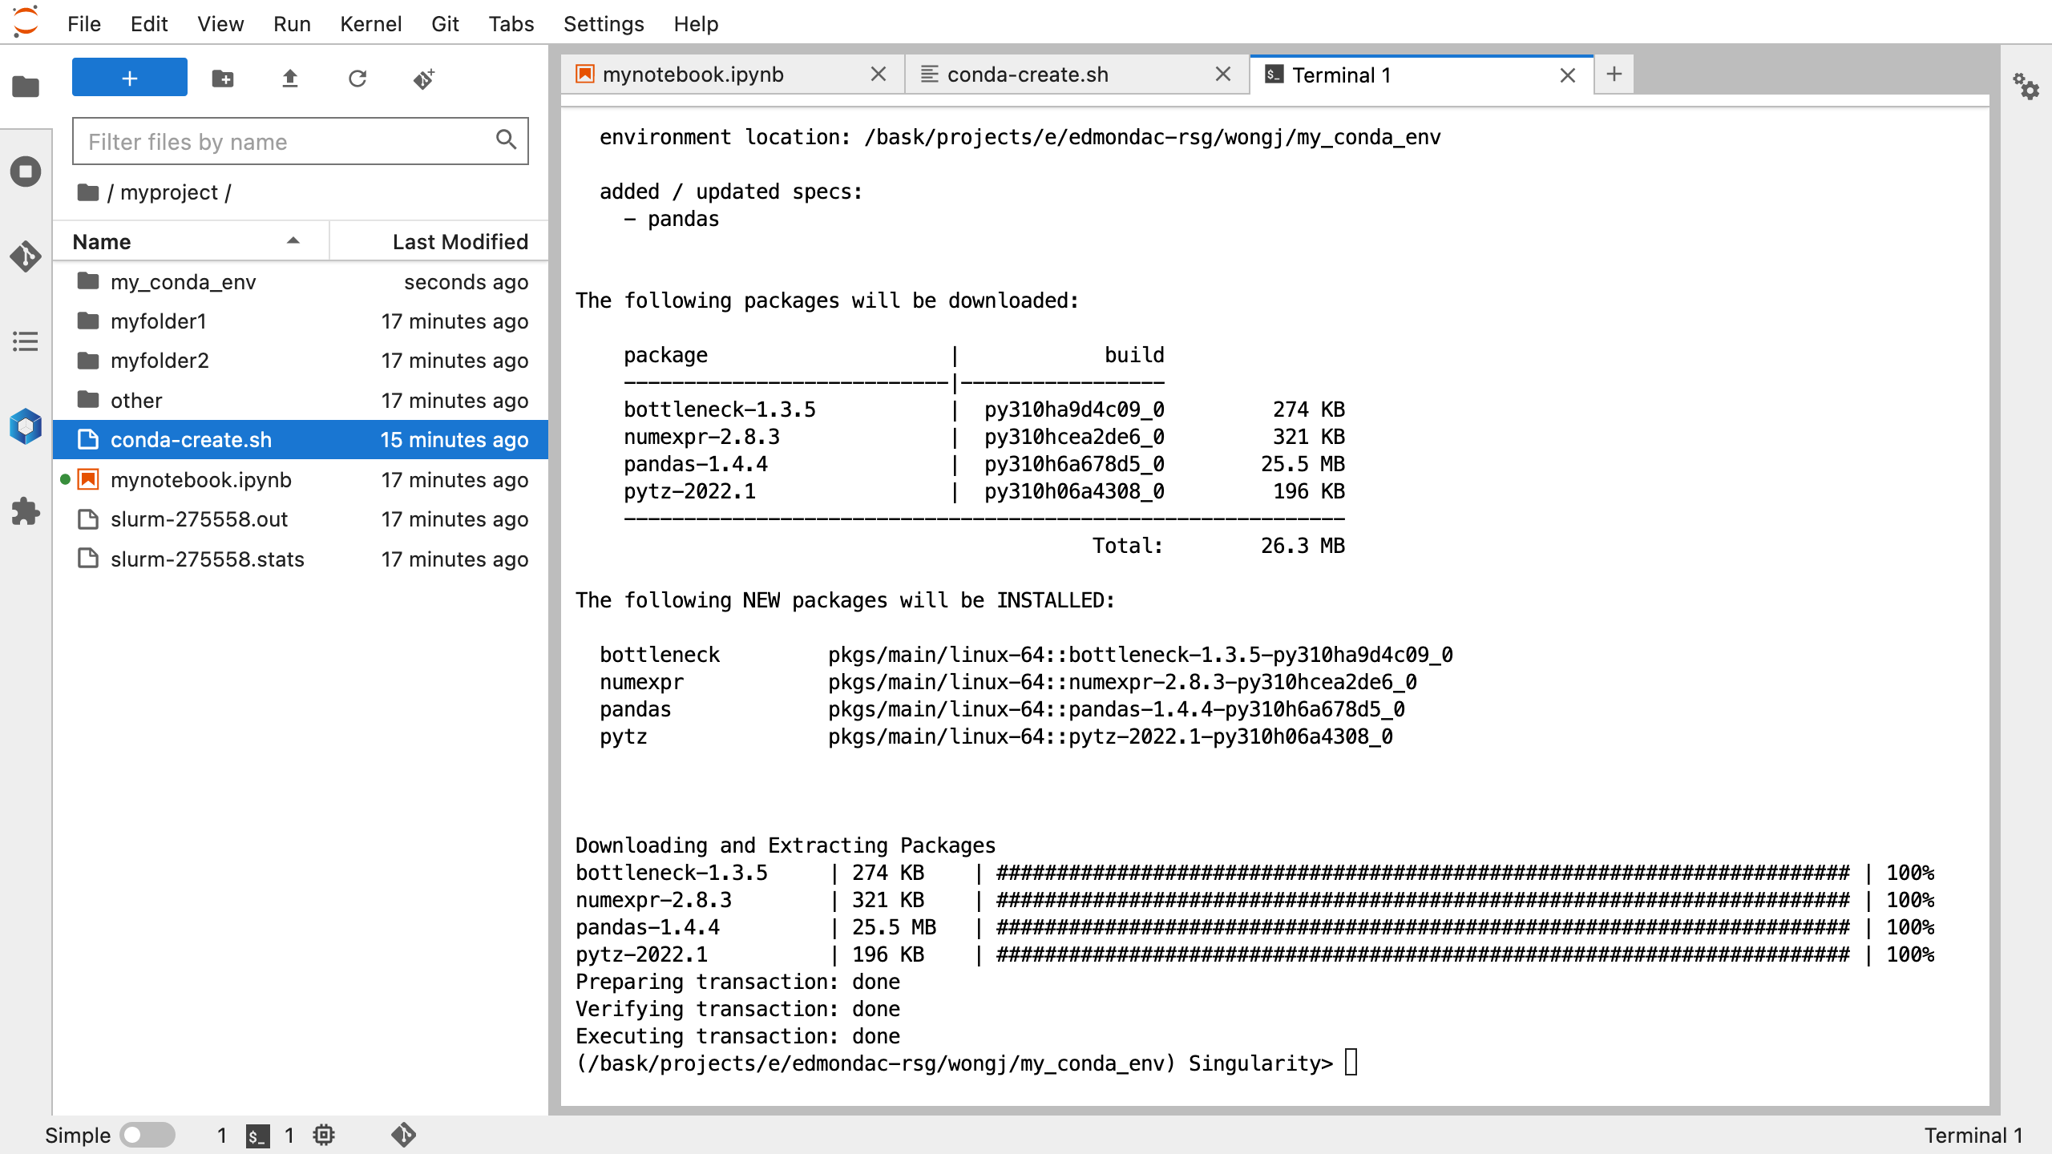
Notes:
Open a terminal window
Execute shell commands found in the header conda-create.sh
module purge – unloads loaded modules and resets the environment
module load baskerville – loads the defaul Baskerville environment
module load bask-apps/live – load the stable, default application stack
module load Miniconda – load the conda package manager
eval ”$({EBOOTMINICONDA3}/bin/conda shell.bash hook)” – initialise conda
export $CONDA_ENV_PATH – define location for the conda environment, emphasise that will need to be amended according to project folder and is lower case only
export $CONDA_PKGS_DIRS=“/tmp” – download packages to temporary storage
conda activate “${CONDA_ENV_PATH}” – activate the environment
conda list – show list of packages installed in active environment
conda install pandas --yes – install pandas package

Slide 68

Notes:
Switch back to mynotebook.ipynb

Slide 69
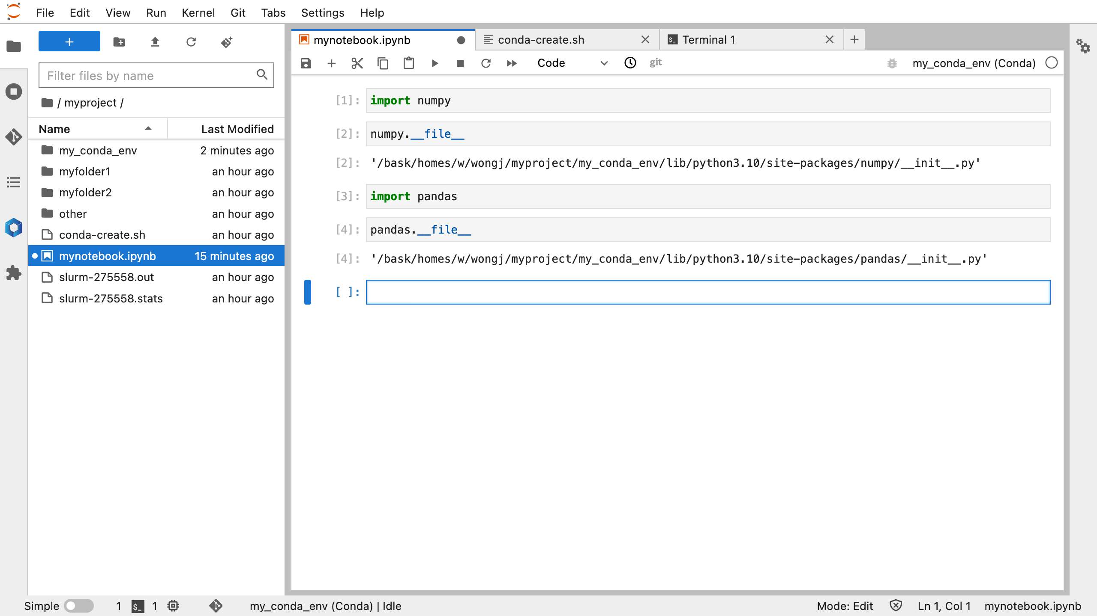
Notes:
Switch back to mynotebook.ipynb
import pandas
pandas.__file__ - check file location of pandas installation

Slide 70
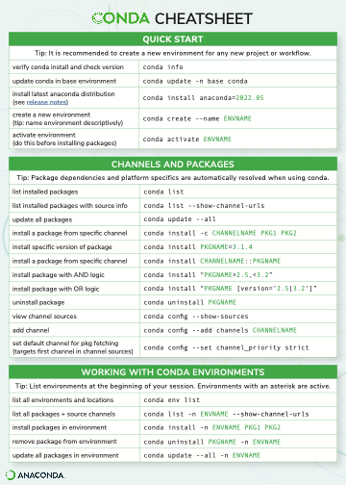
More Conda commands
Consult the Cheat Sheet
https://docs.conda.io/projects/conda/en/latest/user-guide/cheatsheet.html
https://github.com/baskerville-hpc/baskerville-portal
Notes:
Consult the Conda Cheat Sheet for more commands
https://docs.conda.io/projects/conda/en/latest/user-guide/cheatsheet.html
https://github.com/baskerville-hpc/baskerville-portal

Slide 71
Tips
Do not mix Module Loading and Conda Environments
This can result in version conflicts and incompatible software
Module loading is preferred where possible
These system-wide applications are built and optimised specifically for Baskerville, resulting in better performance and compatability
Not easily customisable if the module you want does not exist, although we are happy to install more module applications at your request
Conda Environments are customisable, but can be large
When modifying your Conda environment, add the conda install commands into your shell script for reproducibility (helpful for troubleshooting)
Run conda env remove --prefix <$CONDA_ENV_PATH> to delete an environment
Run conda clean --all to clear your Conda cache in your home folder
Remember to shutdown your JupyterLab notebook when you are done
Consult https://docs.baskerville.ac.uk/portal/portal/ for more advice
Notes:
Building a large conda environment with compatible packages can be complicated, make sure you can reproduce your work by adding the conda install commands into your shell script for reproducibility
Use conda env remove –prefix, since we have specified our conda environment path in a project folder (normally you can remove conda environments by name, but that only works if your environment lives in your home folder)
conda clean –all empties the cache in your home folder, which can still get full despite export $CONDA_PKGS_DIRS=/tmp

Slide 72

Final Task – PyTorch Conda Environment
https://github.com/baskerville-hpc/baskerville-portal
Create another Conda environment using a shell script
conda install --yes pytorch torchvision pytorch-cuda=11.6 -c pytorch -c nvidia
Launch a JupyterLab server
import torch
Check torch.__path__
Check torch.__version__
Query visible GPU devices with the commands from pytorch-gpu.py
pytorch-gpu.py

Slide 73

Congratulations!
Useful links:
https://docs.baskerville.ac.uk/
https://admin.baskerville.ac.uk/
https://apps.baskerville.ac.uk/
https://portal.baskerville.ac.uk/
https://github.com/baskerville-hpc/baskerville-portal
Email:
baskerville-tier2-support@contacts.bham.ac.uk

